Slide 1
QNJAC – Road Haulage sub-committee
Reducing tipper rollovers
Safe loading
Toolbox talk

Slide 2
Target audience
All those responsible for maintaining the safety of persons involved in, or adjacent to, tipper loading and discharging activities
Notes:
This tool box talk is to share information with those involved in tipper loading to minimise the risks associated with tipping roll overs

Slide 3
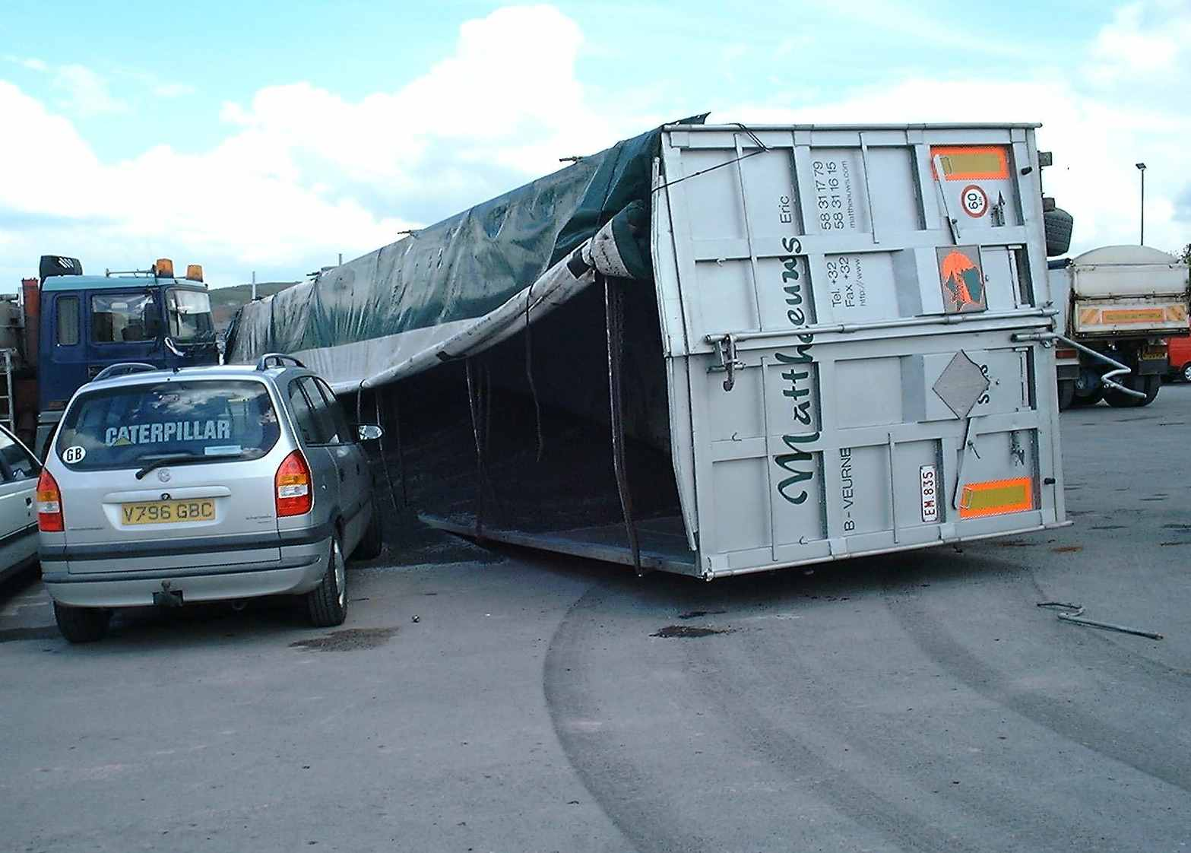
Presentation objective
To keep everyone involved in or adjacent to tipper loading and discharging activities safe
Notes:
Its key to engage all involved in the safe process of loading and unloading tipping vehicles

Slide 4
Tipper rollovers
Rollovers represent the single most dangerous none highway incidents involving tippers
Rollovers continue to result in serious injuries and fatalities
Notes:
Rollovers represent one of the most dangerous none highway incidents involving tippers and incidents can lead to serious injury or fatalities

Slide 5
What can we do to reduce roll over's ?
Notes:
Training, awareness and control can significantly reduce the risk of a tipper roll over

Slide 6
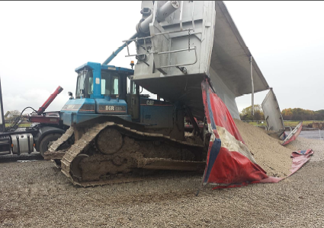
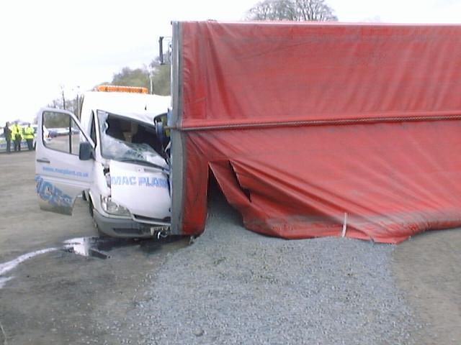
The impact of safe loading on safe tipping
There are many factors that can contribute to tipper overturns.
Many of these can be addressed and eliminated prior to the tipping operation by appropriate management, planning and safe loading of the vehicle
Notes:
Many factors can contribute to a tipper roll over - its key that exclusion zones are maintained to keep people safe

Slide 7
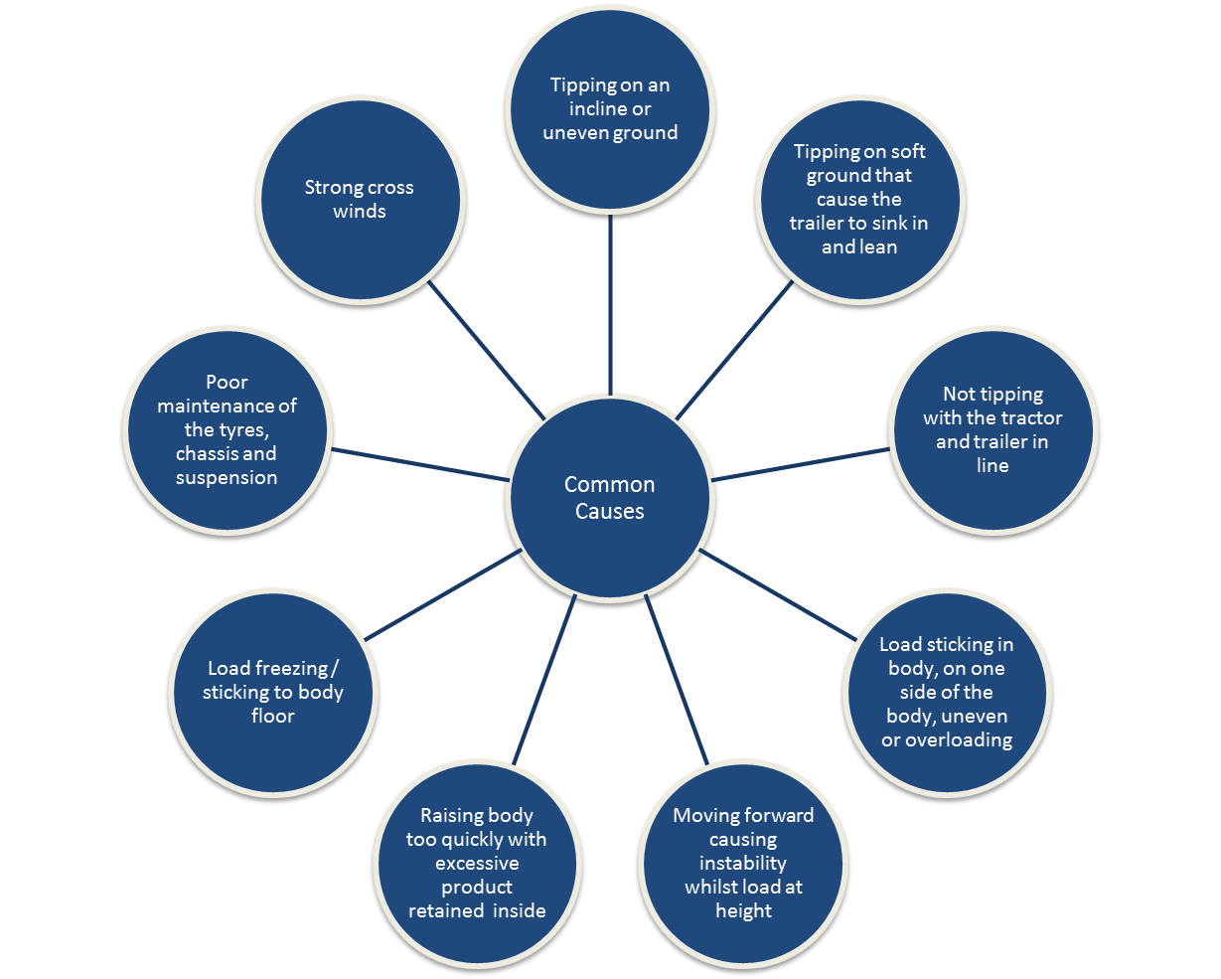
Several factors can contribute to a tipper overturn:
Notes:
Several factors can contribute to a tipper overturn - its key we understand what they are

Slide 8
The Law
If a driver fails to discharge a load or operate a tipping vehicle safely, both the haulier and driver may be responsible for seriously injuring themselves or others, perhaps even fatally.
In addition, all other parties involved in managing the safety of operations at the loading and discharge locations, may also be held responsible. This would include quarry operators, and site managers.
Employers, owners and managers have a responsibility to provide and maintain safe systems of work, and to take reasonable and practical precautions to ensure the health and safety of all workers and members of the public who may be affected by their activities.
All drivers, including the self employed, have a responsibility for their own health and safety, and that of other people who could be affected by their actions
Notes:
The law states our responsibilities

Slide 9
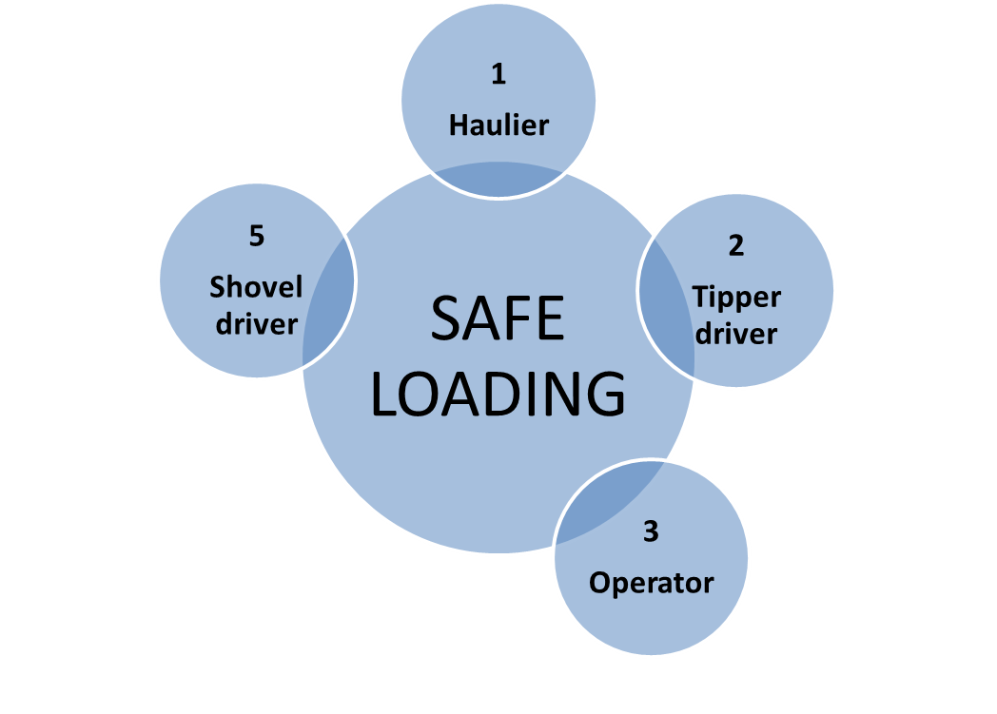
Safe loading of tippers requires a team effort
4
Weighbridge staff
Notes:
Its a team effort from of all the key staff involved in the process of safe loading

Slide 10
1. Hauliers/Fleet owners
Ensure all tippers supplied are fit for purpose, and are well maintained
Check all your drivers are undertaking their daily prestart checks and ensure any defects are appropriately addressed
Ensure drivers are suitably competent to operate the vehicle and are trained and monitored to minimise the risk of overturns
Provide drivers with any appropriate generic or specific safety information they may need for safe loading
Authorise drivers to stop the loading process, if they believe safety is being compromised
Notes:
Hauliers and Fleet owners have key responsibilities

Slide 11
1. Hauliers/Fleet owners (cont)
Authorise drivers to stop the loading process, if they believe safety is being compromised
Consider installing low friction liners in the tipper body of vehicles which may be required to carry material which may be prone to sticking
Notes:
Drivers need to be empowered to stop loading or unloading if they think safety is being compromised

Slide 12
2. Tipper drivers
Ensure the tipper body is clean prior to arrival. Only enter your tipper body if you are following an approved safe working procedure
Report to the weighbridge, or other designated point or person, upon arrival. Ensure you understand how to get to the loading point, and the procedure for how the loading will be undertaken
Obey site safety and traffic rules, including any specific loading instructions
Report to the vehicle owner, and damage to the tipper floor which could result in material being retained during tipping
Wherever possible remain in your cab and wear your seat belt
Notes:
Drivers have key responsibilities to follow safe working procedures

Slide 13
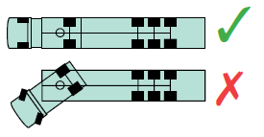
2. Tipper drivers (cont)
Follow all instructions and position the vehicle safely at the loading point. Park articulated
vehicles straight
Where fitted, use weighing devices, but never raise the body to check the weight when
the loading bucket is in it
Wait for the loading process to complete before driving off
At a safe designated area, check that the material is evenly distributed. Report any
uneven loading to site management
Once loaded and on the highway, drive safely and smoothly, so as not to destabilise the load
Notes:
Drivers have key responsibilities to ensure operational safety

Slide 14
3. Quarry operators
Liaise with fleet owners to ensure that drivers will know what to expect when they arrive at site
Provide appropriate signage to assist with this, and wherever possible ensure it matches signage used on public roads
Identify specific products or circumstances where drivers may find difficulty discharging the load smoothly and ensure the driver is made aware of this prior to loading. Consider the storage and assessment of material, and where possible, put measures in place to assist the material release
When arranging tipper haulage, ensure the vehicle planned is suitable for the products to be carried
Where possible, schedule tipper arrival at site to smooth out the loading process and minimise congestion
Notes:
Quarry operators have key responsibilities

Slide 15
3. Quarry operators (cont)
Establish a regime to enable new tipper drivers to be suitably inducted to the site. Where appropriate, provide hard copies of relevant information, such as site layout plans etc
Ensure haul roads and loading areas are well signposted and designed to provide good visibility and minimise the need for reversing at the loading point
Provide firm level ground at all areas where loading is planned
Ensure the loading shovels are suitably sized to reach over the highest sided tippers they will be expected to load
Notes:
Quarry operators have key responsibilities

Slide 16
3. Quarry operators (cont)
Provide appropriate training for shovel drivers to enable them to load different types of tipper bodies
Where loading from a conveyor or bin is provided, ensure that tipper drivers are provided with the appropriate information about the process, and establish provisions for communication, in the event of any problems. Ensure that the discharge chute is designed to enable the material to be loaded evenly
Notes:
Quarry operators have key responsibilities

Slide 17
3. Quarry operators (cont)
Where possible, supervise loading operations
Establish procedures to facilitate good communication between all parties, so that tipper drivers can remain in their cab
Provide a suitable tip off area which can accommodate any overloaded vehicles
Ensure provisions are in place to deal with potential situations such as vehicles in need of cleaning out prior to loading, overloaded or unevenly loaded vehicles, snagged sheets etc
Provide a designated area for tippers to be sheeted, and loads checked for even distribution
It’s good practice to provide weighbridge operators with cameras for them to check in the back of tipper bodies
Notes:
Quarry operators have key responsibilities

Slide 18
4 Weighbridge staff
Provide tipper drivers with an appropriate level of information and instruction to enable them to access and load at the correct point
Refer to management, or follow appropriate procedures for any drivers who may be unable to comprehend this
Ensure all new drivers receive additional assistance and information
Notes:
Weighbridge operators have key responsibilities

Slide 19
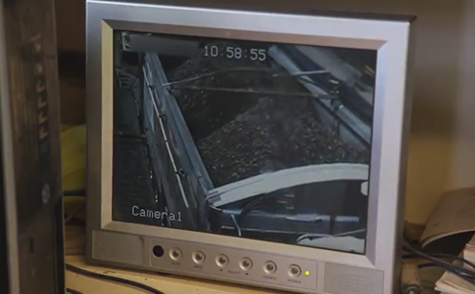
4. Weighbridge staff (cont)
Where provided by a customer, pass on to tipper drivers any relevant site specific instructions, such as a delivery plan
Where cameras are provided, check for even loading on vehicles, and advise the driver of any issues
Notes:
Weighbridge operators have key responsibilities

Slide 20
5. Loader drivers
Park tippers with their tail end facing the stockpile
Maintain loading areas by keeping them firm, level and free from the buildup of debris
Plan the loading process taking account of the tipper specification, so as to prevent any damage to any easy sheet system and associated centre stays
Load the tipper body correctly along its length and evenly across its width
Notes:
Loader drivers have key responsibilities to ensure the vehicle is correctly loaded
20

Slide 21
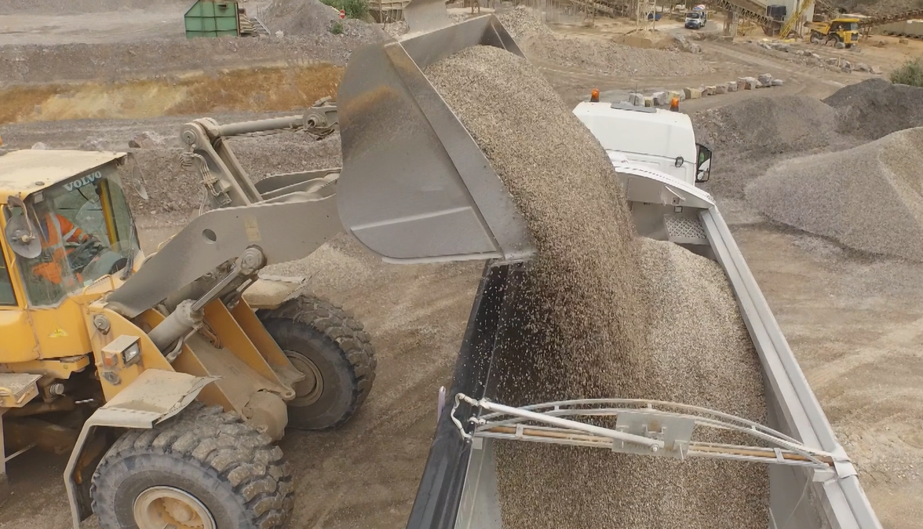
5. Loader drivers (cont)
Ensuring correct loading along the length
Always start at the front
Tippers with weighers will need to slightly raise tipper bodies to check final weight, whilst completing fine loading at rear
Notes:
Loader drivers have key responsibilities to ensure the vehicle is correctly loaded

Slide 22
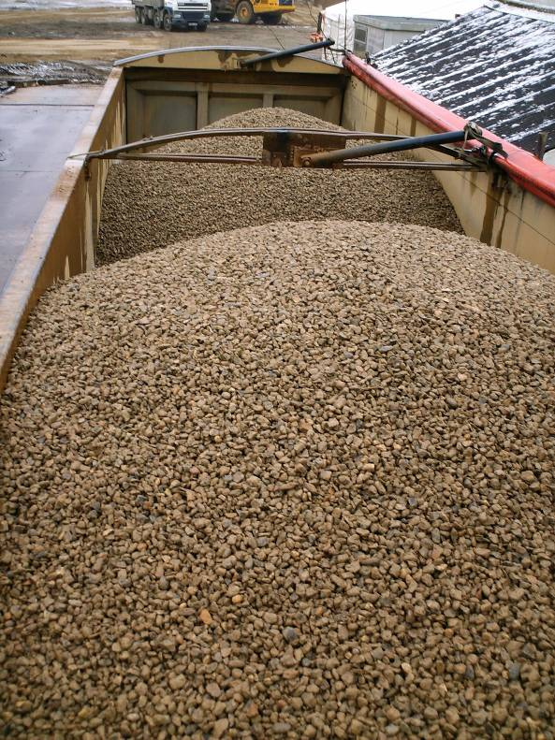
Correctly loaded Artic
5. Loader drivers (cont)
Ensuring correct loading along the length
Finish loading towards rear but over middle
trailer axle
Load at front first
Notes:
Loader drivers have key responsibilities to ensure the vehicle is correctly loaded

Slide 23
Correctly loaded 8w
5. Loader drivers (cont)
Ensuring correct loading along the length
Load only just reaches tailgate
Remaining 50% placed towards rear, leaving sufficient space to provide a gap at the tailgate
Load from front first (approx 50% of load)
Notes:
Loader drivers have key responsibilities to ensure the vehicle is correctly loaded

Slide 24
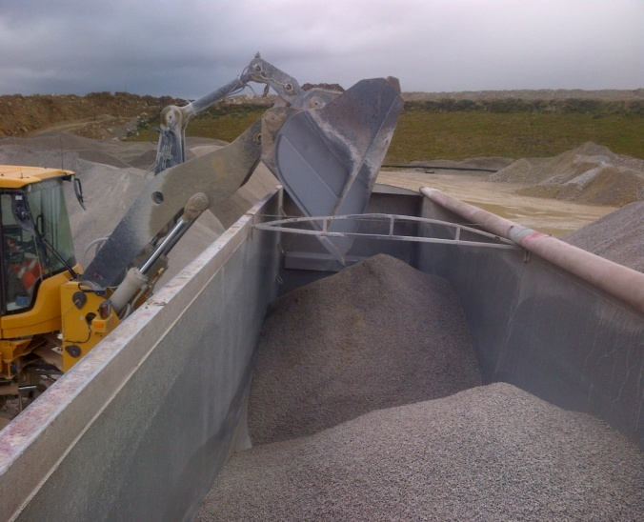
5. Loader drivers (cont)
Ensuring even loading across the width
Discharge into the tipper body with the bucket in the first half of the width
The momentum of the material falling from the bucket will deliver it into the centre of the tipper width
Discharging into the middle of the tipper body width will result in material falling into the second half of the width
Notes:
Loader drivers have key responsibilities to ensure the vehicle is correctly loaded
24

Slide 25
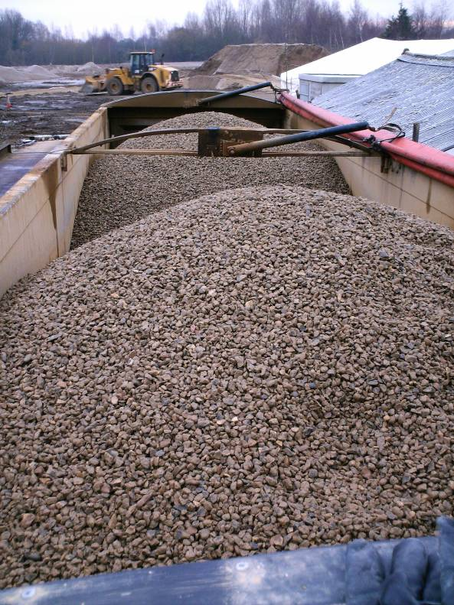
Poorly loaded Artic
5. Loader drivers (cont)
Load split evenly back and front
This can have an adverse effect on axle weights.
Notes:
Loader drivers have key responsibilities to ensure the vehicle is correctly loaded

Slide 26
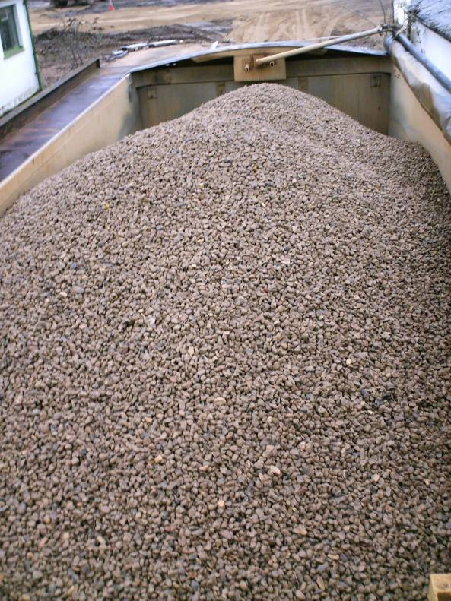
Poorly loaded 8w
5. Loader drivers (cont)
Loaded on one side to Tailgate
Loaded centrally at the front
Notes:
Loader drivers have key responsibilities to ensure the vehicle is correctly loaded

Slide 27
Conclusion
Tipper overturns represent a significant risk to those involved in and adjacent to the loading and discharging activities
There are many factors that can contribute to tipper overturns
Many of these can be addressed and eliminated prior to the tipping operation by appropriate management, planning and safe loading of the vehicle
Good teamwork is essential between all parties to reduce the risk of overturns
Notes:
Tipper overturns represent a significant risk to those involved in and adjacent to the loading and discharging activities
There are many factors that can contribute to tipper overturns
Many of these can be addressed and eliminated prior to the tipping operation by appropriate management, planning and safe loading of the vehicle
Good teamwork is essential between all parties to reduce the risk of overturns

