Slide 1
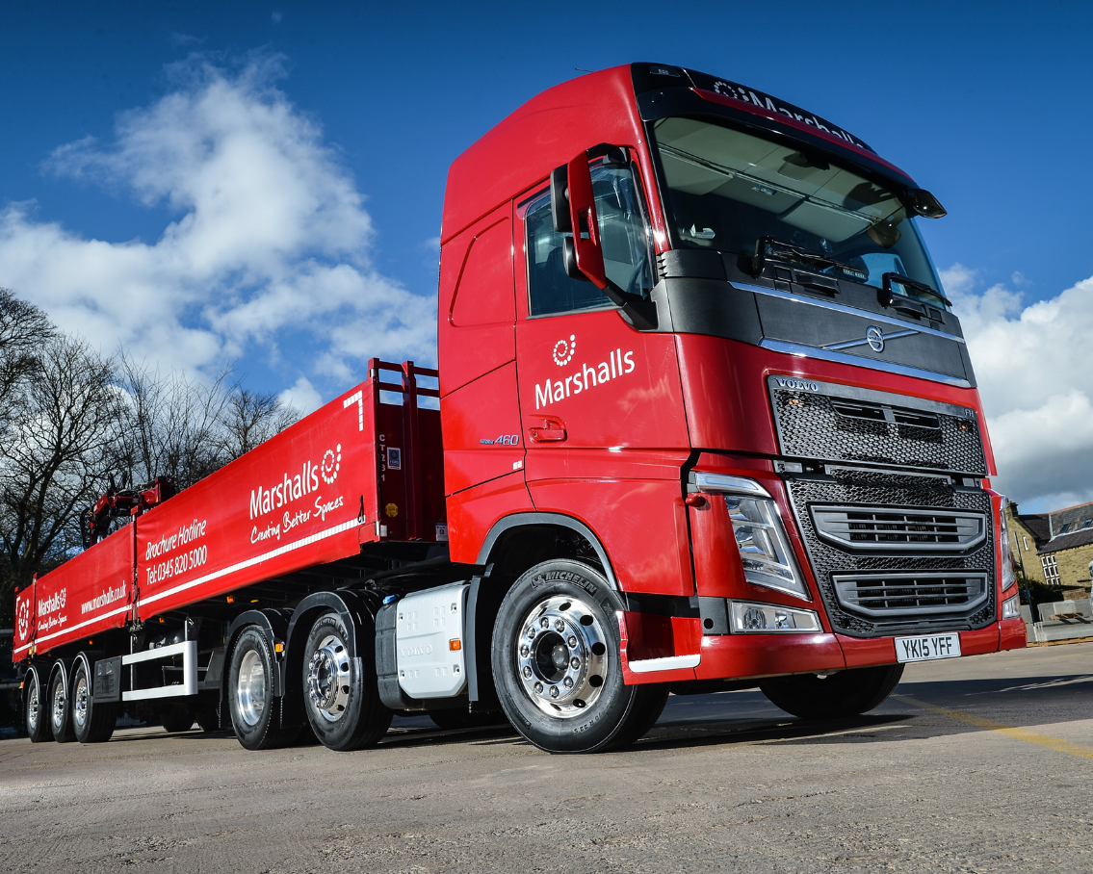
Marshalls Logistics
Road Safety within Schools Campaign 2022
Notes:
(Check before the presentation to ensure no child within the audience has been involved in or lost someone close to them due to an RTA or similar. Check with the teachers that they are ok to continue)
Welcome everyone to the Marshalls Road Safety within schools campaign 2022
Introduce yourself to the audience (Driver Trainer) & (Driver)
Explain what you do and how long you’ve worked at Marshalls
Explain why you're here today and what the children can expect from the session – (session will be approx. 90 minutes long, 30 minutes presentation, 60 mins vehicle/crane demonstration)
Introduce Marshalls and explain what we do as a business, briefly explain the different businesses that make up Marshalls
Talk about road safety, specifically involving large vehicles like the ones we operate within Marshalls.
Move to next slide

Slide 2
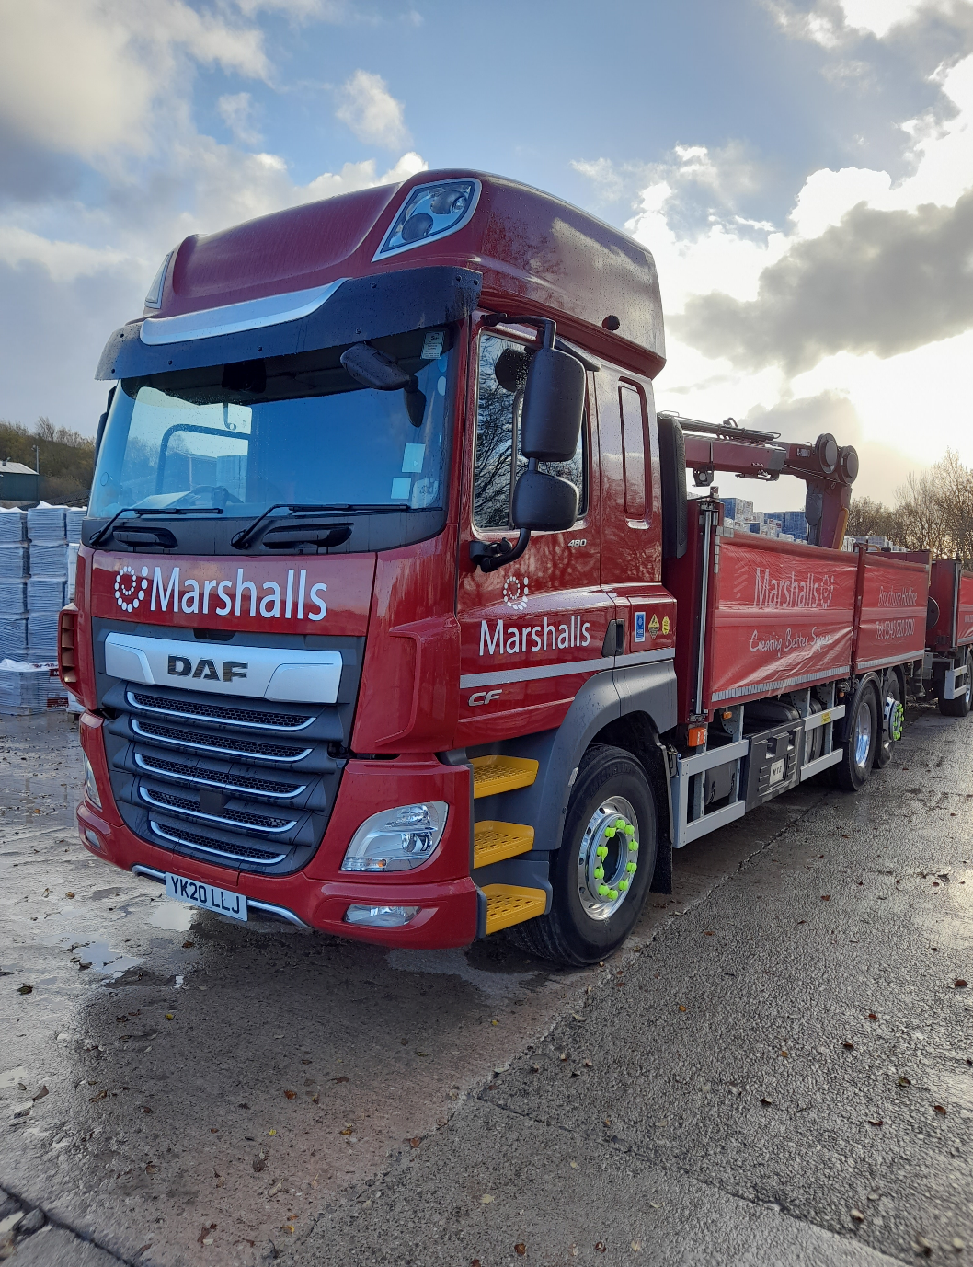
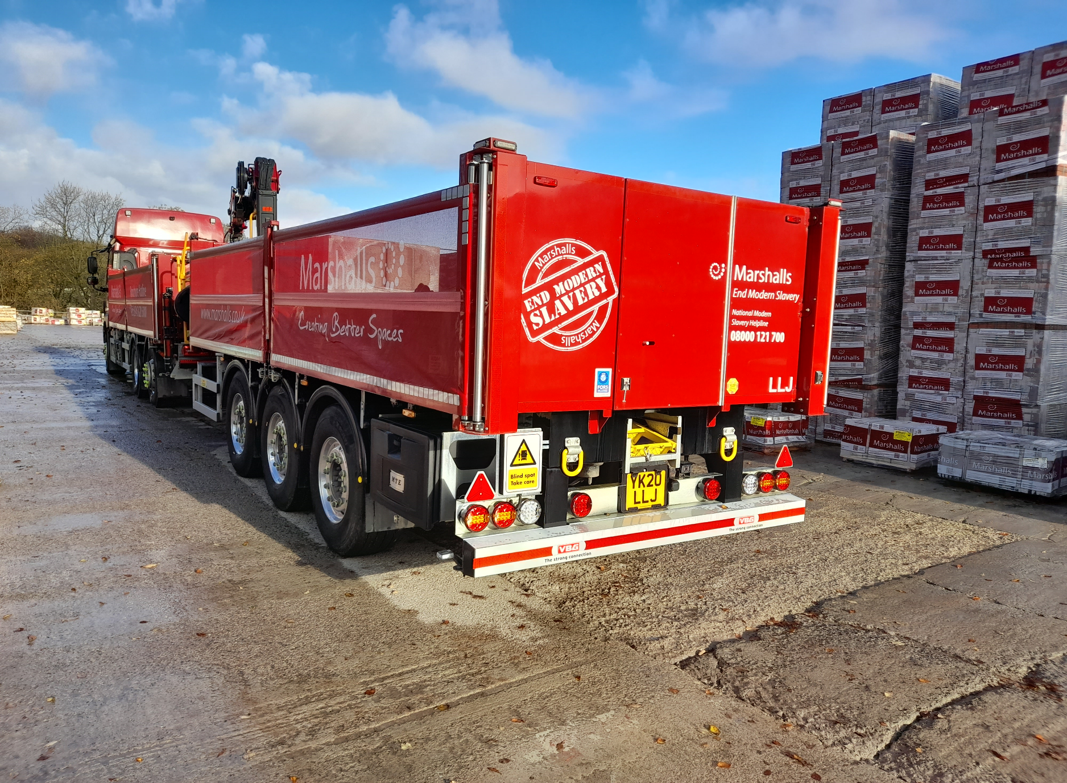
Notes:
Explain to the children the different types of vehicles that make up our fleet and talk about the fleet size
Explain what a drawbar vehicle is and how it is used within Marshalls
Move to next slide

Slide 3
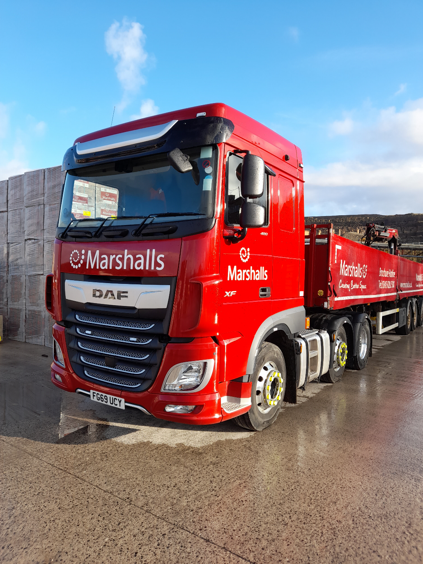
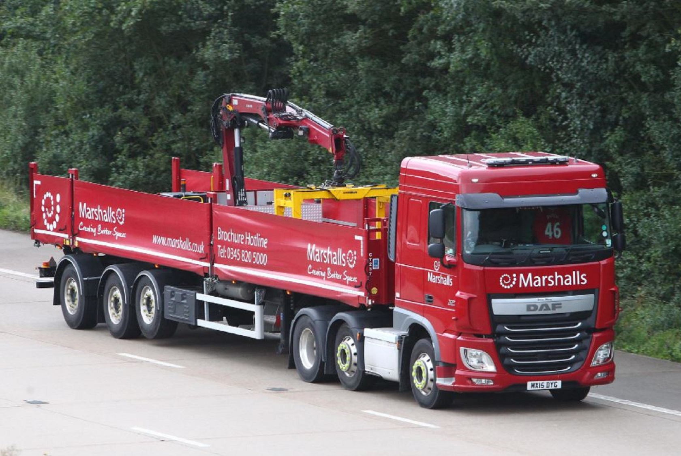
Notes:
Explain what an artic crane vehicle is and how it is used within Marshalls
Spend some time explaining to the children the dangers of large vehicles, especially HGVs.
Share some HGV stats:
Using 2019 stats:
251 people were killed,
1111 seriously injured
4172 slightly injured, in road traffic accidents involving HGVs like the ones in the photographs
20% of collisions which kill a cyclist are with an HGV – This increases significantly in London
Move to next slide

Slide 4
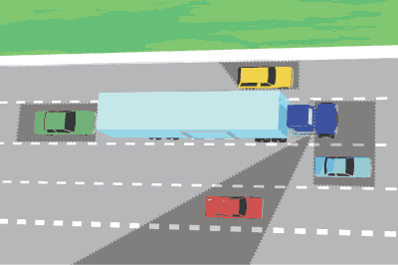
Notes:
Talk to the children about the lorry blind spot, detail the areas in the photo and explain that the driver can’t see the children in the different areas:
(Explain to the children that after the presentation, we will allow the children into a real lorry so they can see what its like from a drivers perspective and a fun exercise where we will recreate the blind spot exercise shown in the photo
Talk about some of the stay safe equipment that our vehicles are equipped with to help keep children/pedestrians and other vulnerable road users safe:
Onboard camera systems
Mirrors
Stickers
Sensors
Alarms
Move to next slide

Slide 5
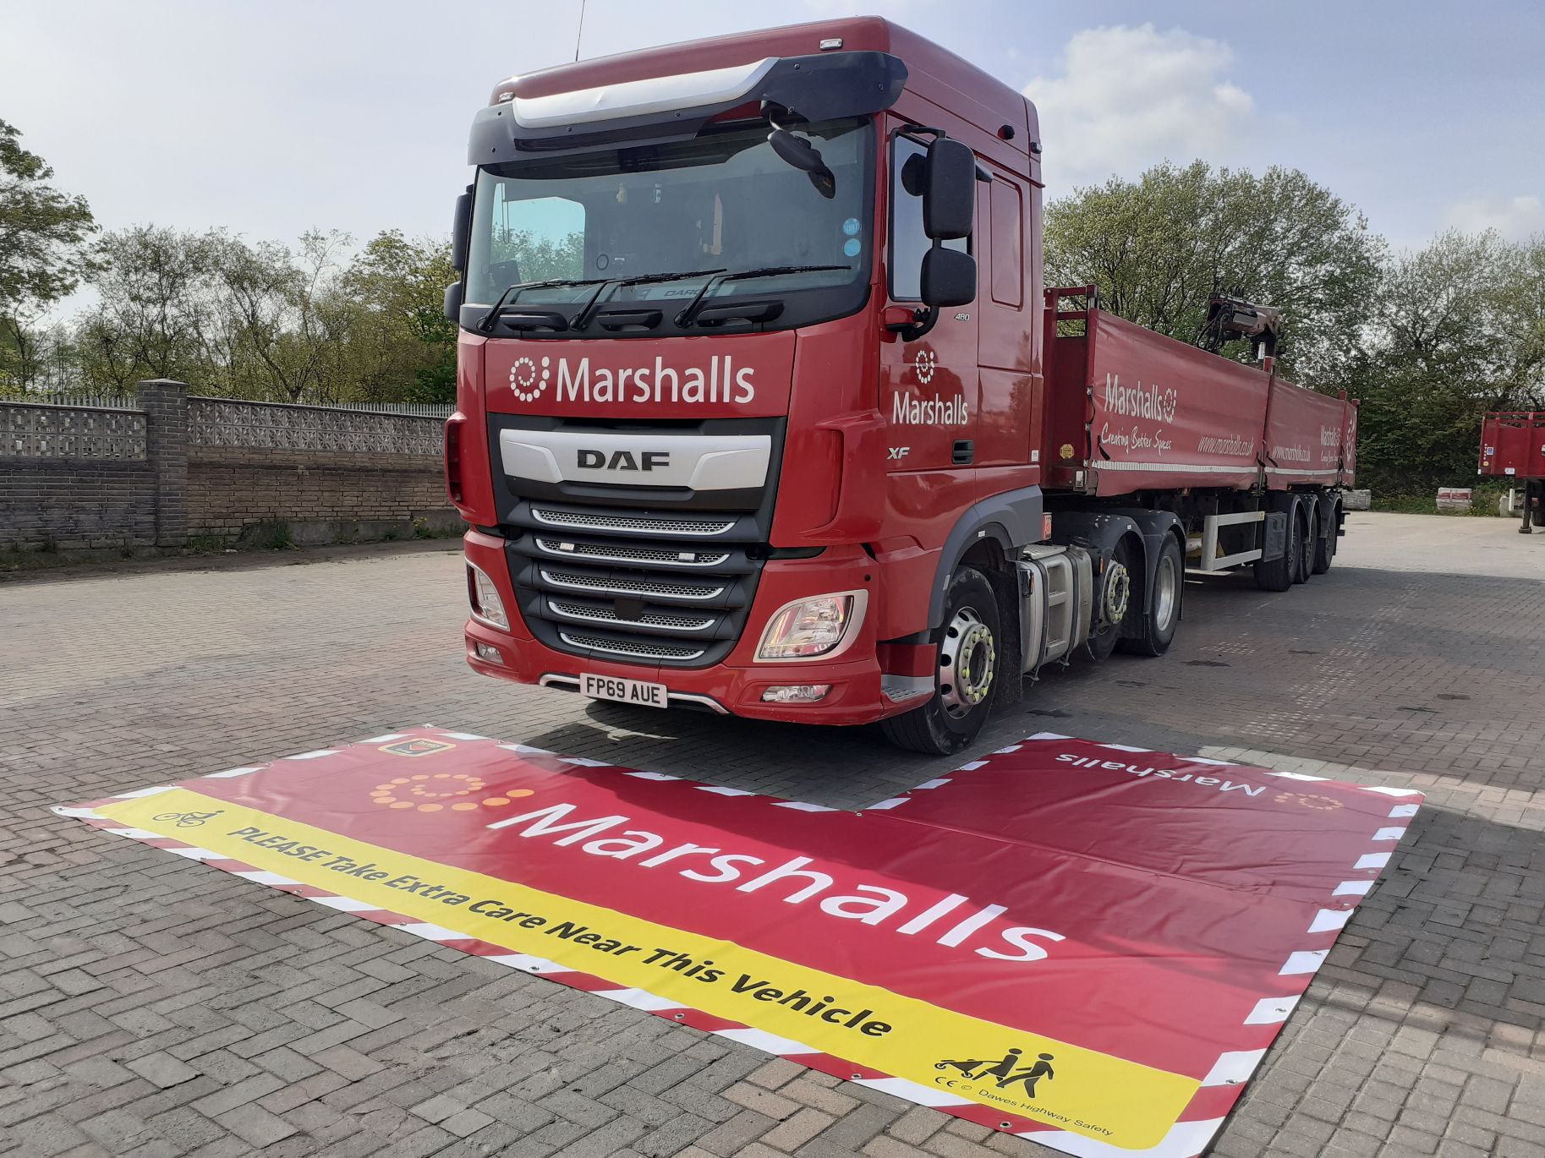
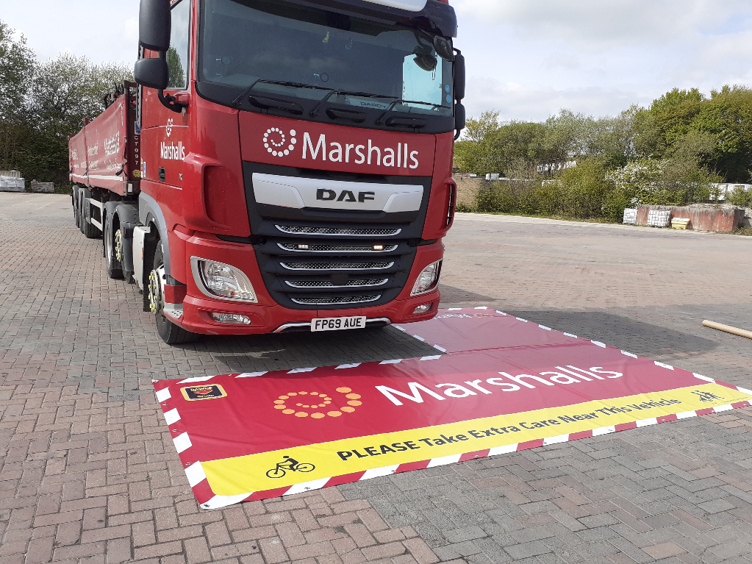

Slide 6
Notes:
Lorry Blindspot
Before we go out into the school yard and get in a real lorry, have a look at this short video clip that highlights the danger of the drivers blind spot
Lessons and key points to take away from todays presentation:
HGVs are very dangerous vehicles
Whilst the vehicle is queuing waiting to manoeuvre:
You should never walk alongside the vehicle in the road, stay well clear and stick to the pavement
Never stand next to the cab, if you cant see the driver, the driver cant see you
Never take a short cut and climb over the trailer coupling or worse still never crawl under a vehicle
If you're a cyclist, never rest on a vehicle when stationery
When queuing in traffic, try not to pull up alongside a lorry, for the reasons we’ve just seen, the drivers blind spot
The above messages can be reiterated during the practical session, when its easier to demonstrate

Slide 7
Marshalls Logistics
Road Safety within Schools 2022
Notes:
Thank you and summary
Thank the pupils for listening and when it comes to road safety they can make a difference and they have important roles to play as leaders for road safety. They can be good role models by asking grown ups to keep them safe near roads.
Explain that the children can now have a look at a Marshalls lorry and even get in the cab to see what the lorry driver sees (or cant see) from his seat!
Outside demonstration: (children to wear Marshalls hi-visibility vest and hard hat)? – Maybe we could purchase a set that we take with us, depending on numbers?
Out In the school yard, demonstrate the blind spot exercise using the ‘blind spot mat’
Let the children take turns in standing in the different areas of the mat, whilst other children sit in the cab viewing the blind spot for themselves
Take photos (if permitted) of children in the cab
Once all children have had a go at sitting in the cab and standing on the mat, the driver will give a demonstration of the crane, lifting a couple of products (with the children at a safe distance)
Reiterate the below key points:
HGVs are very dangerous vehicles
Whilst the vehicle is queuing waiting to manoeuvre:
You should never walk alongside vehicle in the road, stay well clear and stick to the pavement
Never stand next to the cab, if you cant see the driver, the driver cnt see you
Never take a short cut and climb over the trailer coupling or worse still never crawl under a vehicle
If you're a cyclist, never rest on a vehicle when stationery
When queuing in traffic, try not to pull up alongside a lorry, for the reasons we’ve just seen, the drivers blind spot
Finish off the session by thanking the children for attending and handing out pens/badges/keyrings

