Slide 1

Articulated Tipper Roll Over's

Slide 2
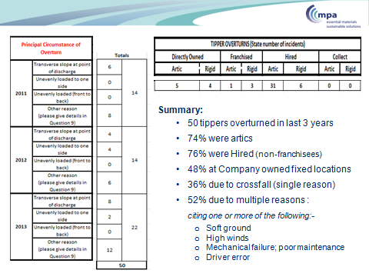
MPA UK Statistics 2011 - 2013
MPA Reported - 37 x Artic Roll over’s in last 3 years across its UK members
In this period CEMEX had 5 x roll over’s (13.5% of MPA total) - plus 2 x 3rd party supplier inbound included in MPA stats

Slide 3
Roll over Causation
A tipper can become unstable and overturn when tipping on a cross slope as low as 5º
Investigations revealed that most roll over’s resulted from more than one single factor
  Tipping on an incline or uneven ground
  Tipping on soft ground that cause the trailer to sink and lean
  Not tipping with the tractor and trailer in line
  Load sticking in body, on one side of the body, uneven or overloaded
  Moving forward causing instability whilst load at height
  Raising body too quickly with excessive product retained inside
  Load freezing / sticking to body floor
  Poor maintenance of the chassis and suspension
  Strong cross winds

Slide 4
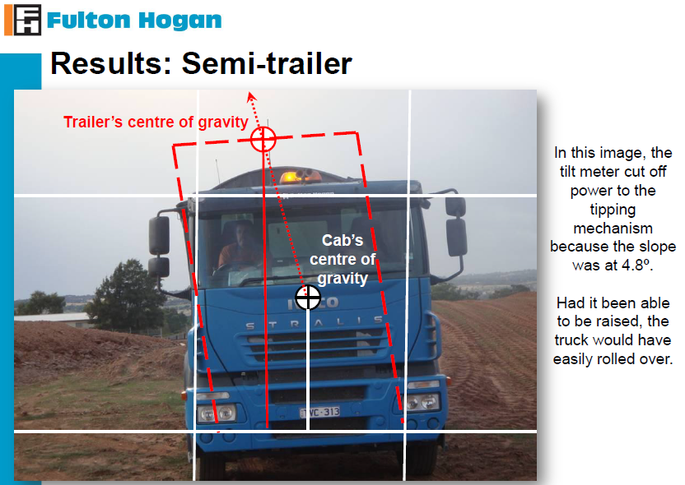
Roll over Causation
Notes:
CEMEX - Artic Roll Over Statistics. 2008 – 2013
2013 - Average of 300+ Artic vehicles used per day from a pool of 3000+ vehicles
2008 2009 2010 2011 2012 2013 Averages
No of CEMEX Loaded Roll Over's 2 2 2 1 1 3 1.8
No of 3rd Party Loaded Roll Over's 1 0 0 0 1 1 1.0
Total Roll Over's 3 2 2 1 2 4 2.3
Frequency per 100,000 for CEMEX loaded artic movements
- 1.27 1.23 0.53 0.62 1.86 1.10
Total Artic Movements n/a 156869 162671 189324 161468 161437 166353.8

Slide 5
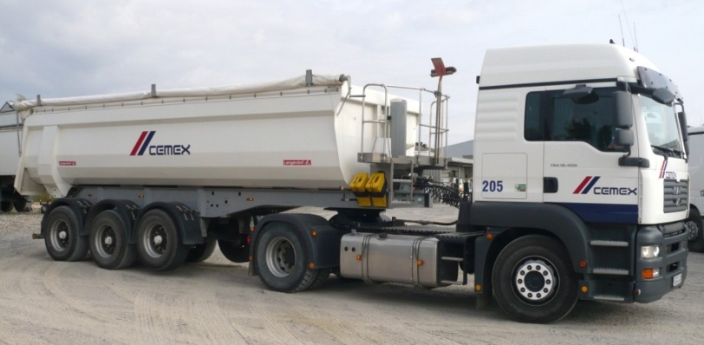
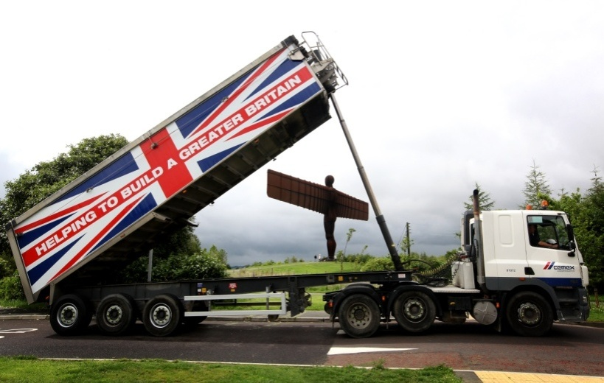
German comparison
CEMEX Germany has no recorded incidence of vehicle roll over’s – Hence contact for potential best practise.
Main observation is that the German operations use smaller aggregate bodied trailers.
German artic rated at 23.8 M3 capacity (40 tonne GVW) significantly smaller than UK equivalents which are 38 -70 M3 (44 tonne GVW).
CEMEX Germany Artic 23.8 M3 capacity (40 tonnes GVW)
CEMEX UK Artic with a aggregate body 55 M3 capacity semi bulker (44 tonnes GVW)
Notes:
Germany has no recorded incidence of vehicle roll over’s – Hence contact for potential best practise.
Team could not recall any roll over events in Germany in recent years – but did state that it was possible some may have occurred at 3rd party sites and not recorded.
Artic vehicle movements and sub contractor haulage activity is comparable to UK, with very similar operations, materials and delivery sites with uneven ground etc
Similar driver and haulier training and safety activities are undertaken and inclinometers are not widely installed.

Slide 6
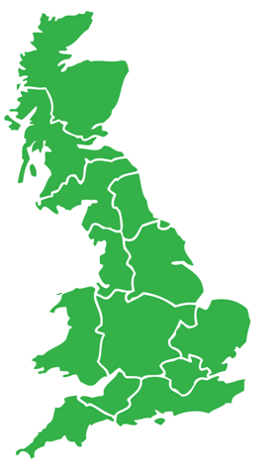
Locations of Artic Tipper Roll Over's 2008 - 2013
12
6
5
10
13
2
1
3
7
11
9
4
14
8
Notes:
1 - 2013 Burtonwood, Warrington
2 – 2013 Steelphalt, Rotherham
3 – 2013 Burtonwood, Warrington
4 - 2013 Witney Concrete Plant, Oxford
5 – 2012 Easington, Network Rail. Bulby, Yorks
6 – 2012 Kilbarchan, Renfrewshire
7 – 2011 Plasmor, Widnes
8 – 2010 Bridgewater distribution site, Sommerest
9 - 2010 Ryall quarry, Worcestershire
10 – 2009 Fridaythorpe, Yorkshire
11 – 2009 Berkswell quarry, Coventry
12 – 2008 Hill End quarry, North Lanarkshire
13 – 2008 Spaunton, North Yorkshire
14 – 2008 Caerleon block works, Cardiff

Slide 7
UK Artic Roll Over – Root Cause Analysis
(2008 – 2013)
  57 % of Roll over's occurred on CEMEX Sites (43% External Customer)
  93% incidents involved Contractor vehicles of which half had been sub-subcontracted
  The one CEMEX fleet incident involved an Agency Driver
  79% had Bulker type trailer bodies
  79% had no inclinometer fitted
  4 incidents RCA cited inexperienced drivers
  Driver hours / Fatigue not cited as an issue
  86% occurred on unmade stocking yards
  Materials carried tended to contain high moisture : - Dust 43%, Sand 29%, MOT 21%
Camber, Rushing, Load Distribution are the 3 main causes of Roll over
Analysis of RCA’s for 14 Roll Over’s between 2008 – 2013
Notes:
1. Sites (43% External Customer)
2. (75% of artic volume is delivered by contractors / 25% on CEMEX own fleet)
3. None
4. (ratio consistent with fleet make-up)
5. (of the 3 fitted 2 were set up incorrectly)
6. None
7. None
8. None
9. Dust 43%, Sand 29%, MOT 21%
Camber, Rushing, Load Distribution are the 3 main causes of Roll over
Analysis of RCA’s for 14 Roll Over’s between 2008 – 2013

Slide 8
RCA - Root Causes cited
Date | Incident Location | Camber / Induced Camber | Rushing | Load Distribution | Load Sticking | Inexperience / Training | Mechanical | Inclinometer not set up
18/11/2013 |  | 1 | 1
24/09/2013 |  | 1 | 1
14/08/2013 |  |  | 1 | 1 | 1 | 1
08/08/2013 |  | 1 | 1 |  |  | 1
20/07/2012 |  | 1 |  | 1
18/05/2012 |  |  | 1 | 1 | 1
13/07/2011 |  | 1 | 1 |  |  |  | 1
08/12/2010 |  | 1 |  |  |  | 1
04/06/2010 |  | 1 |  | 1
30/09/2009 |  | 1 |  | 1 | 1 |  |  | 1
19/01/2009 |  |  |  |  |  |  | 1
29/10/2008 |  | 1 | 1 |  | 1 |  | 1
25/09/2008 |  | 1 | 1 |  | 1 | 1 |  | 1
14/02/2008 |  |  |  | 1
 |  | 10 | 8 | 6 | 5 | 4 | 3 | 2

Slide 9
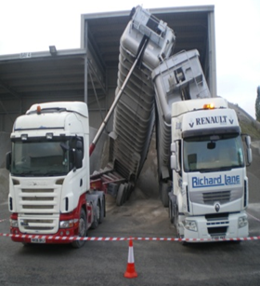
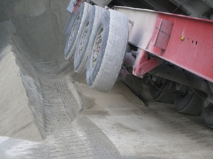

Incident Learning Points Summary
Vehicle Rollover – 24th September 2013
Brief Details of Incident
2 artic tippers were delivering limestone dust to an independent customer site – one delivery was from CEMEX, the other from a competitor. Both loads were being delivered by the same contractor - the CEMEX load via one of hauliers’ sub contractors. The haulier own vehicle arrived on site first, was directed to the tipping area, where the driver got out to release the manual tailgate as the 2nd tipper was reversing into position next to him. The 1st driver got back in the cab and commenced tipping. At this point the 2nd tipper which had an automated back door - had already started to tip. The1st tipper was just over a quarter elevated when the driver looked in the mirror and noticed the 2nd tipper body with the CEMEX load - tipping over towards him. The 2nd tipper body came to rest on the RLT tipper. The incident occurred at 05:45 - in a flood lit yard – but with the bays in darkness. Both drivers were in their cabs during tipping and were wearing their seat belts - Neither driver sustained any injuries.
Learning Points From Investigation
The haulier attended last year’s Logistics Health and Safety Leadership day. Incidents from previous rollovers had been cascaded to the haulier – including adopting a 15 metre exclusion zone. Both drivers remained in their cabs during the tipping process and were wearing seatbelts. The haulier confirmed he had cascaded information to drivers he used, but did not have evidence to confirm they had received information about adopting a 15 metre exclusion zone. Multiple tipping at the customer site had been a standard operating practice for sometime. The driver had reversed onto stock material at one side of the bay creating an inclined tipping situation - creating a high likelihood of roll over. The Haulier did not immediately communicate to CEMEX the details of the incident - the Site advised him that they would manage the incident / investigation.

Slide 10
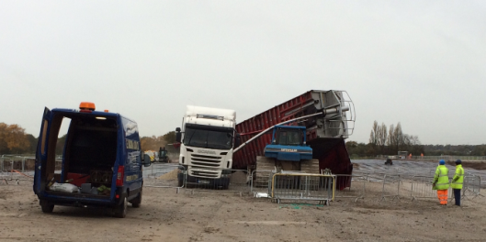
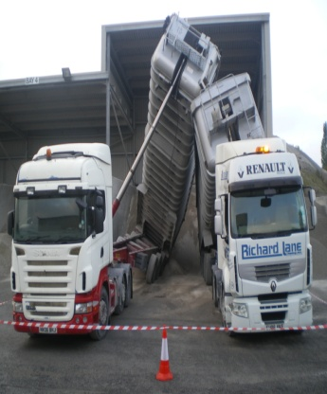
2013 – Burtonwood -
Root Cause: Induced Camber, Rushing
Root Cause: Camber, Rushing
2013 – Steelphalt

Slide 11
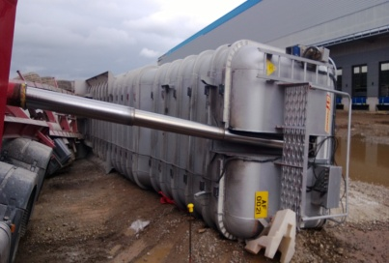
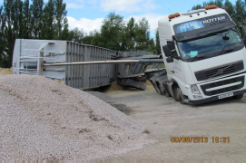
2013 – Burtonwood
2013 – Witney Rmix Plant
Root Cause: Rushing, Load Distribution, Load Sticking, Training
Root Cause: Camber, Inexperience

Slide 12
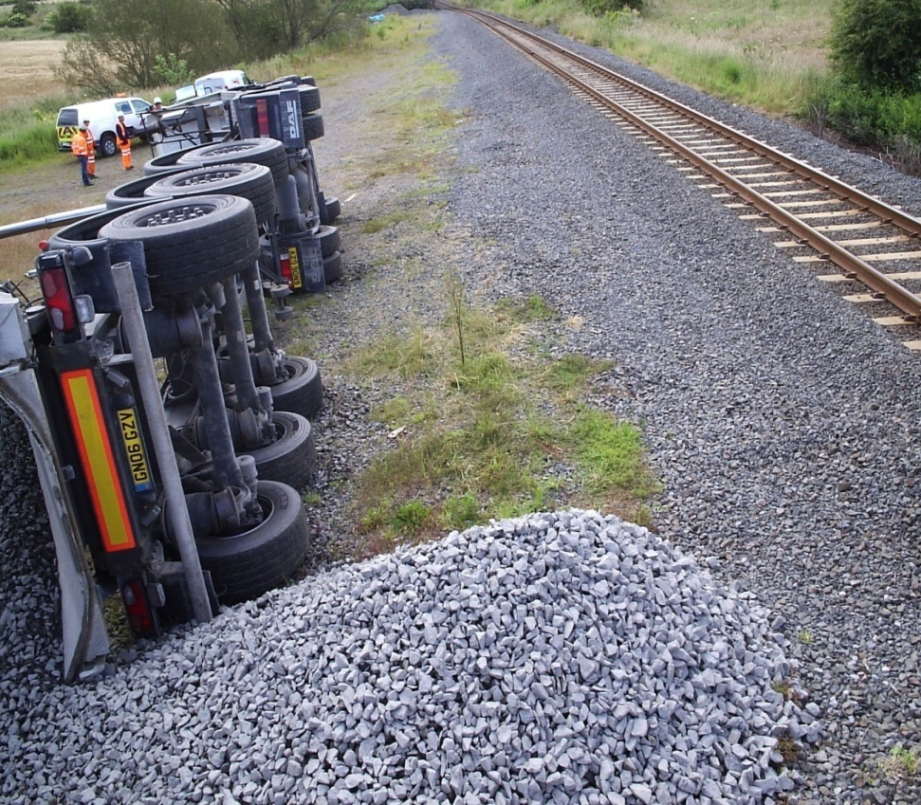
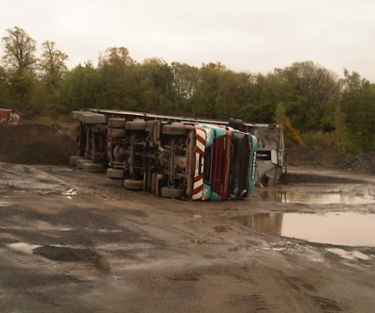
2012 – Easington
2012 – Kilbarchan
Root Cause: Camber, Load Distribution
Root Cause Rushing, Load Distribution, Load Sticking

Slide 13
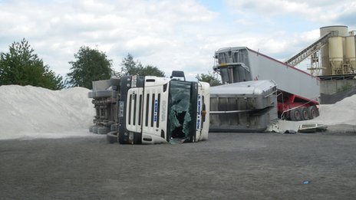
2011 – Plasmor - Widnes
Fatality – Driver David Astley
Root Cause: Camber, Rushing, Under Inflated Tyre
Notes:
11 February 2014 A Widnes based manufacturer has been fined £100,000 after a worker was crushed to death when a tipper truck overturned.
Plasmor (Halton) Ltd was prosecuted by the Health and Safety Executive (HSE) after an investigation found the company failed to have a safety system in place for the delivery of raw materials, despite several tipper trucks coming onto the site every day.
Liverpool Crown Court heard today (11 February 2014) that David Astley had taken a truck of limestone dust to the plant on Tanhouse Lane in Widnes on 13 July 2011. The dust is used by the company to manufacture concrete blocks and slabs for the construction industry.
The 56 year old, from Ellesmere Port, was tipping the load onto the site when another driver arrived at the plant with a second load of limestone. The second driver was told to empty his truck in the same place but, as he lifted the trailer, it overturned and fell on top of Mr Astley’s cab, causing his death.
The court was told the tipper trucks arriving on the site could weigh up to 44 tonnes and the risk of vehicles overturning is well known in the manufacturing and construction industry.
The HSE investigation found Plasmor had failed to carry out a risk assessment for the work and should have made sure vehicles were kept a safe distance apart. The person who directed the drivers onto the site had also not received suitable training.
Plasmor (Halton) Ltd, of Wormersley Road in Knottingley, was fined £100,000 and ordered to pay prosecution costs of £28,634 after pleading guilty to a breach of the Health and Safety at Work etc Act 1974.
“The company should have known there was a danger of tipper trucks overturning, and created exclusion zones to minimise the risk of anyone being injured. Instead, two drivers were allowed to empty their trailers next to each other.
“Plasmor has since changed its procedures so staff are properly trained and tipper trucks are kept at least 20 metres apart. If this system had been in place at the time of the incident then Mr Astley’s death could have been avoided.”

Slide 14
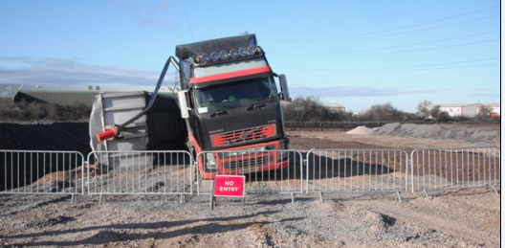
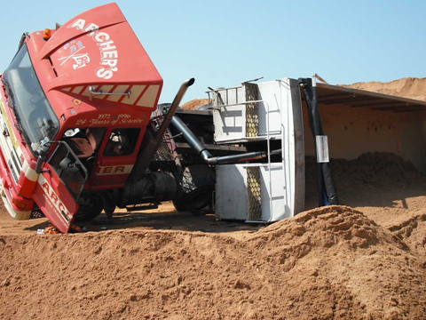
2010 – Bridgewater
2010 – Ryall
Root Cause: Induced Camber, Inexperience
Root Cause: Camber, Load Distribution

Slide 15
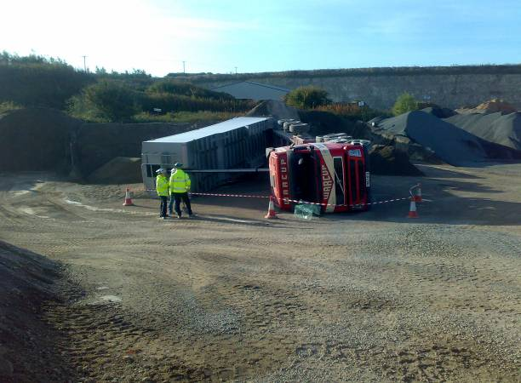
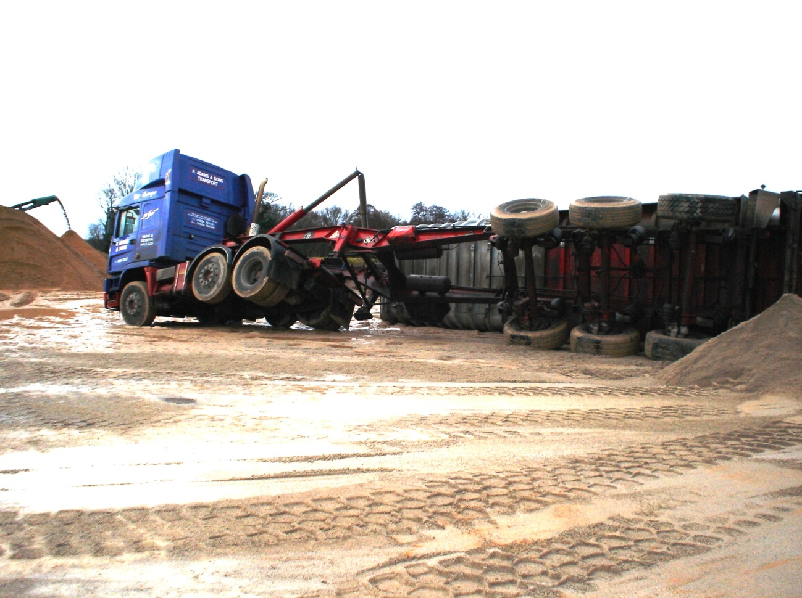
2009 – Fridaythorpe
2009 – Berkswell
Root Cause: Camber, Load Distribution, Load Sticking, Inclinometer not set
Root Cause: Mechanical – Broken Spring - O/S/R road spring on the trailer

Slide 16
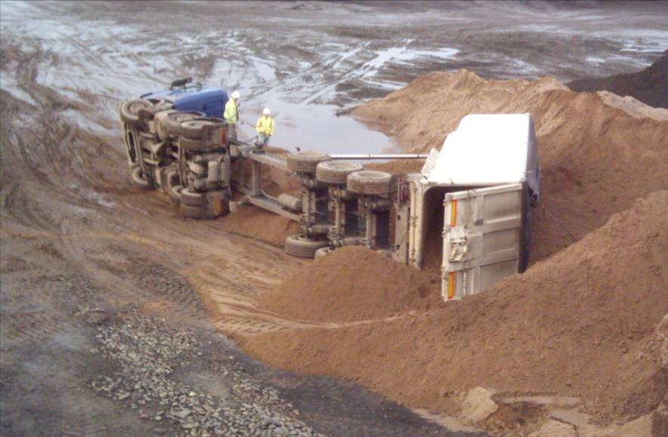
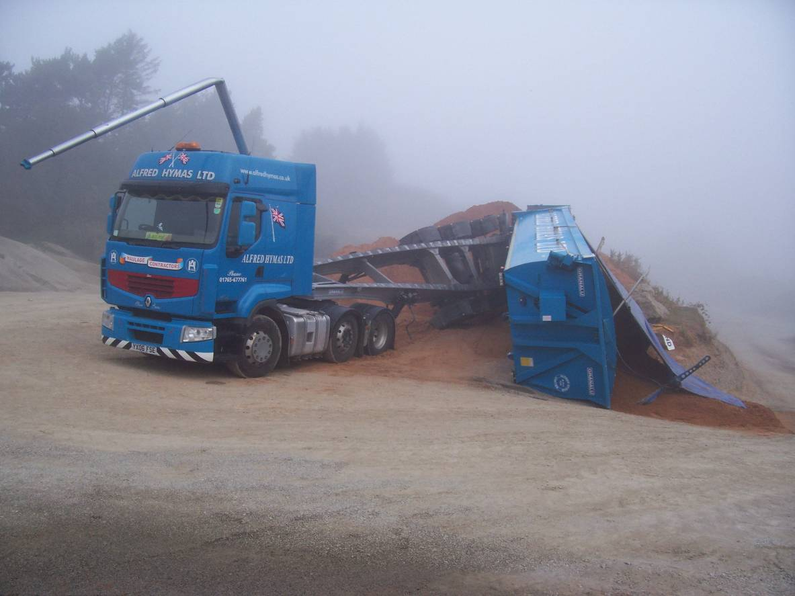
2008 – Hillend
2008 - Spaunton
Root Cause: Camber, Rushing, Load Sticking, 2nd axle not lowered
Root Cause: Camber, Rushing, Load Sticking, Inexperience, Inclinometer not set up

Slide 17
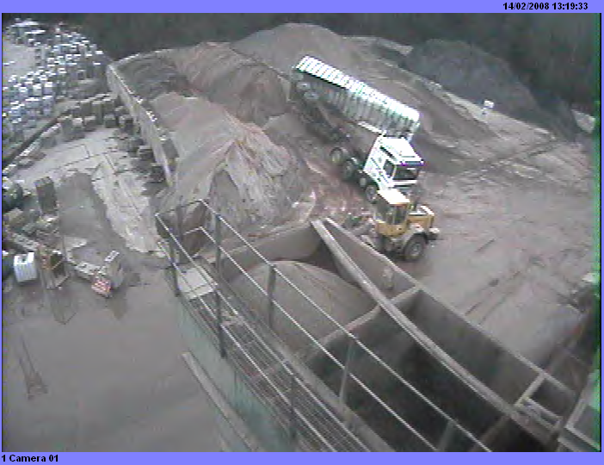
2008 – Caerleon
Root Cause: Load Distribution

Slide 18
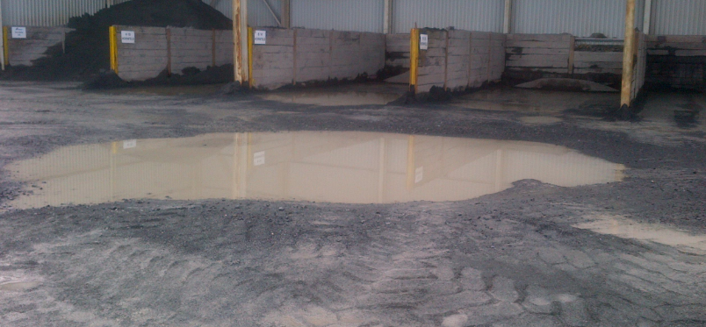
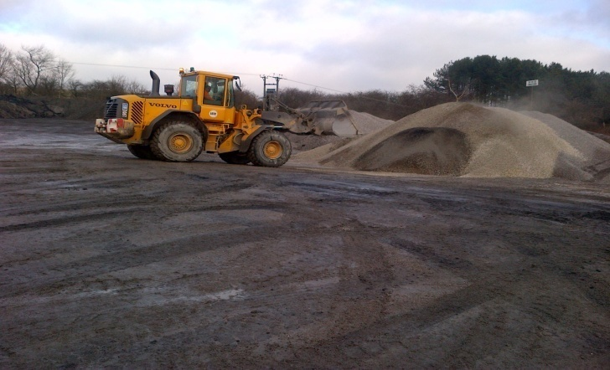
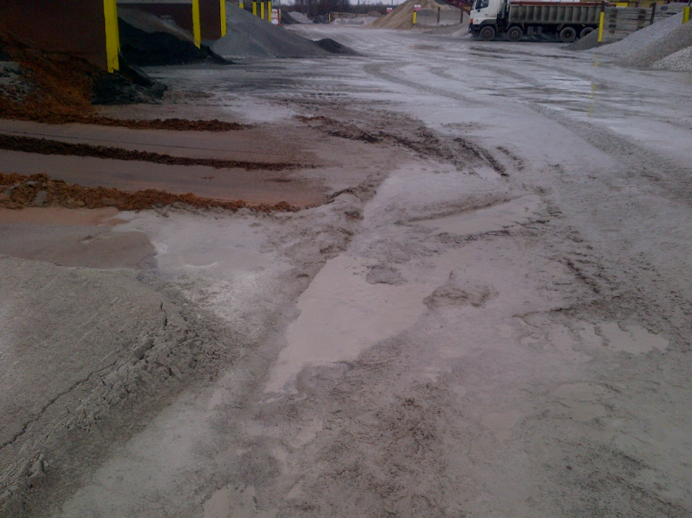
CEMEX – Aggregates site survey – Main highlights
54 site surveys returned – 30 Quarries, 8 Depots, 6 Wharfs, 10 Coating plants
76% of sites have unmade ground stockings areas
96 % have a check and maintenance regime
54% have uneven ground with 22% reporting gradients of +5 degrees
28% of stocking yards are inadequately lit with 19% having no exclusion zone signage
28% have no formal tip off procedures for incorrectly loaded vehicles
17% have no designated tip off area; 30% are inadequately lit and 28% have no exclusion zone signage
28% do not check loads prior to despatch
93% induct all drivers although some sites exclude adhoc and collects
25% of sites believe they have shovels which cannot effectively load the larger bulker artics
Main concerns:
Guidance & Procedures, lighting, exclusion zone areas /signage, inductions, load checks and bulk trailer loading
Notes:
54 site surveys returned – 30 Quarries, 8 Depots, 6 Wharfs, 10 Coating plants
76% of sites have unmade ground stockings areas
96 % have a check and maintenance regime
54% have uneven ground with 22% reporting gradients of +5 degrees
28% of stocking yards are inadequately lit with 19% having no exclusion zone signage
28% have no formal tip off procedures for incorrectly loaded vehicles
17% have no designated tip off area; 30% are inadequately lit and 28% have no exclusion zone signage
28% do not check loads prior to despatch
93% induct all drivers although some sites exclude adhoc and collects
25% of sites believe they have shovels which cannot effectively load the larger bulker artics
Main concerns:
Guidance & Procedures, lighting, exclusion zone areas /signage, inductions, load checks and bulk trailer loading

Slide 19
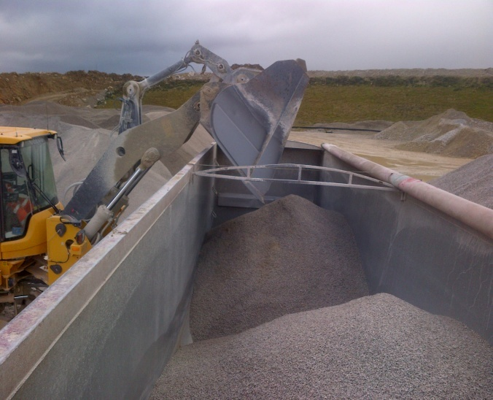
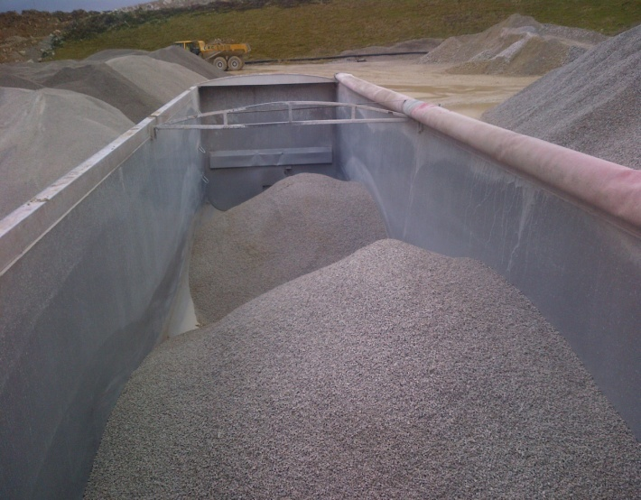
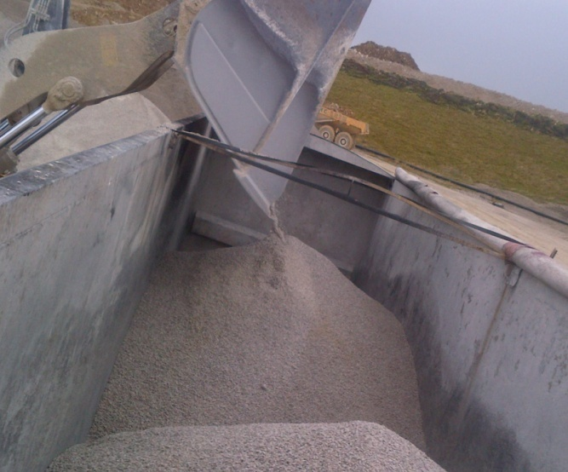


CEMEX – Study of which Shovel types which can reach bulk artics
Photos showing experienced shovel loader using Volvo 150 to load a 65 M3 bulk trailer
Load is being loaded to one side
Load is biased to one side increasing risk of roll over
Shovel driver has adapted loading style to load centrally
44 x Quarries, Depots and Wharfs surveyed had:
15 x shovels too small to load bulkers
34 x Volvo / Cat966 shovels which need care when loading
31 x larger shovels

Slide 20
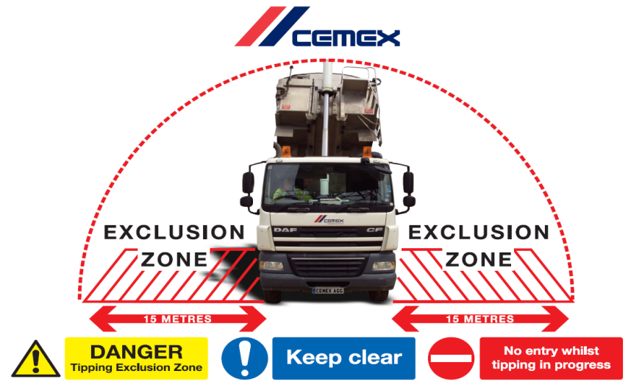
Signage

Slide 21

Inclinometers
Notes:
Inclinometer systems come with or without the tipper cut-off valve and can be used purely as a tipping aid or actively prevent tipping.
Key that they are set up and maintained properly and set to lower alarm of 4 degrees
Preferred option is for tipping cut off which prevents further raising of the body
25% CEMEX Hauliers Vehicles had inclinometers fitted.
MPA target is for compulsory fitment of Inclinometers by 2018

Slide 22
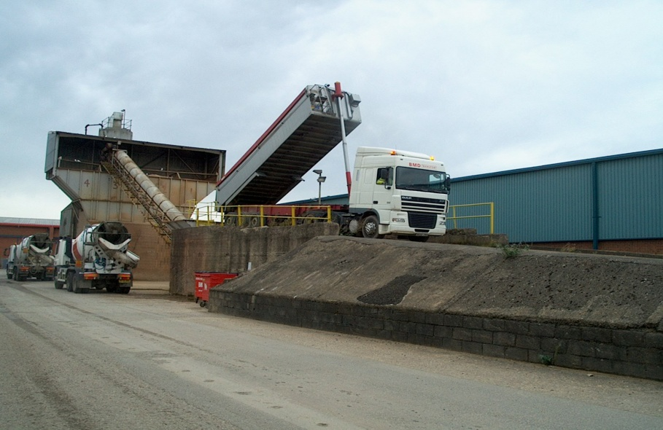
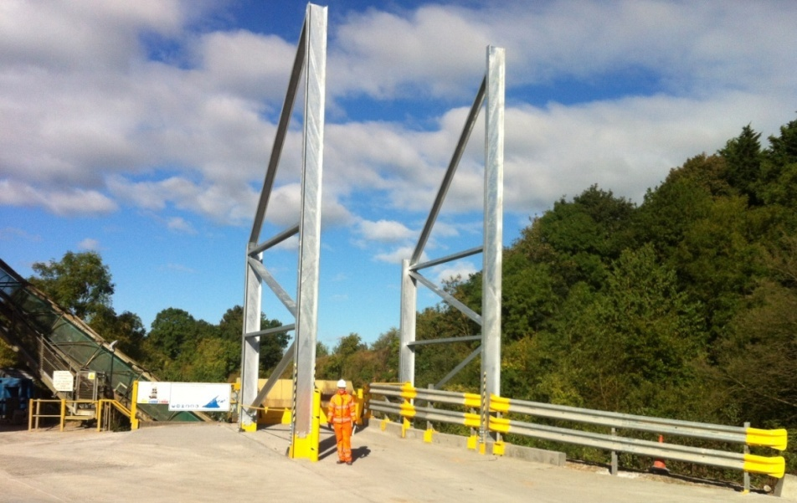
Tipping frames at high risk sites.
No tipping frame installed
Tipping frame installed

Slide 23
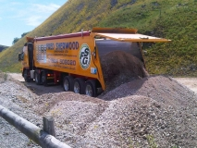
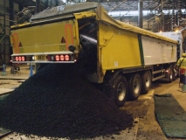
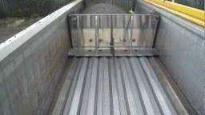
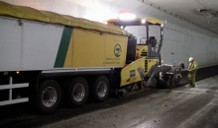
Trailer Type – Walking Floor / Live Bed Bodies
Carry approx 27.5 tonnes – Only very small number in operation

Slide 24
Risk Reduction Options
57% Occur on CEMEX sites
Reduction from Current 2 x Rollovers per annum
Training
Driver, Haulier, Management, Shovel driver, Weighbridge Operator (inductions & procedures)
Improve own sites
De- Risk / Increase control
This could improve likelihood to <1 per annum
Restricted fleet use
No secondary / 100% inclinometers
Significant site investment
Reduce risk to <1 per 2 Years
All fleet fitted with inclinometers
Strict compliance with only flat man made surfaces
Increased customer management
Improved Loading
Best practise rolled out
Risk increased with poor loading and driver rushing
Difficult to manage volume flex
Significant Commercial impact
Driver Error still largest contributor
Large driver workforce with 26% turnover
Very Low Likelihood

Slide 25
9
Controls for the Prevention of Tipper Rollovers:
Prevention
Driver training and awareness
Inclinometer training and set correctly
Load checked prior to dispatch
Customer liaison and roll over prevention and exclusion information provided
Site assessments if required
Hazard alert system - to raise site issues
Exclusion
Drivers refuse to tip if deemed unsafe or no 15m exclusion zone and report to customer service for further instruction
Prevention
Driver training and awareness
Load checked prior to dispatch
Customer liaison and roll over prevention and exclusion information provided
Site assessments if required
Hazard alert system - to raise site issues
Programme to increase number of vehicles to be fitted with inclinometers
Exclusion
Drivers refuse to tip if deemed unsafe or no 15m exclusion zone and report to customer service for further instruction
Prevention
Driver training and awareness
Inclinometer training and set correctly
Load checked prior to dispatch
Site procedures -SSOW , RA and tipping exclusion zones
Site staff training and awareness
Site supervision
Designated, well maintained tip off areas with signage
Exclusion
Drivers do not tip if deemed unsafe or no 15m exclusion zone and report to weighbridge for further instruction
Tipping frames where identified at high risk sites
Prevention
Driver induction ,training and awareness
Load checked prior to dispatch
Hazard alert system - to raise site issues
Programme to increase number of vehicles to be fitted with inclinometers
Site procedures and tipping exclusion zones
Site staff training and awareness
Site supervision
Designated, well maintained tip off areas
Exclusion
Drivers do not tip if deemed unsafe or no 15m exclusion zone and report to weighbridge for further instruction
Tipping frames where identified at high risk sites
CEMEX Site 3rd Party Site
CEMEX fleet / driver Contract Haulier

Slide 26
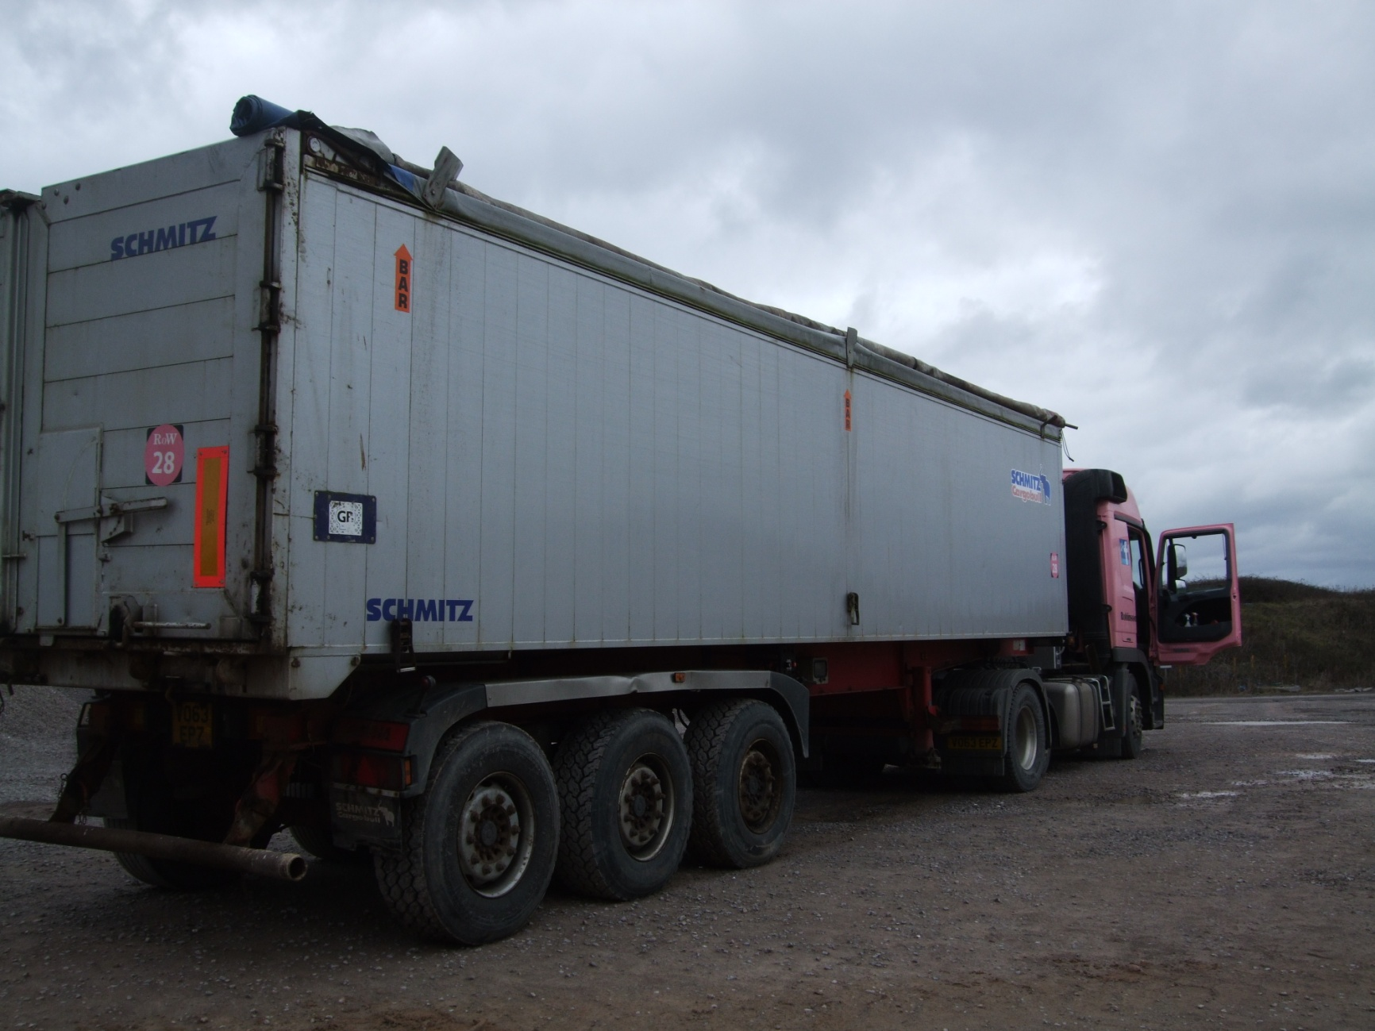
The Driver who said “No”

Slide 27
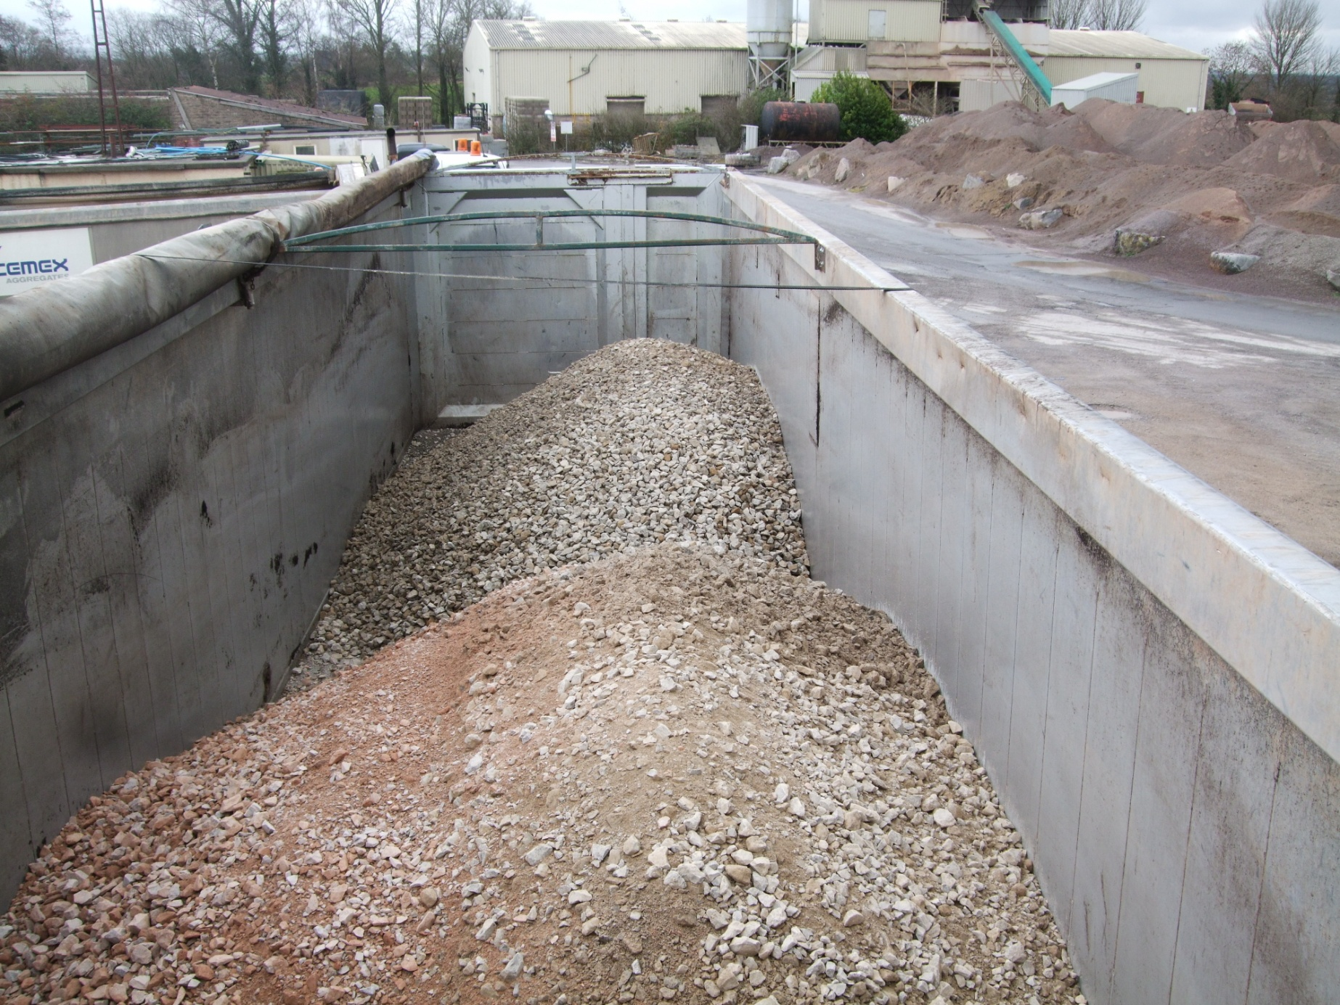
The Driver who said “No”

