Slide 1
Quarry Contractors
Maintaining Safety Standards
Notes:
The purpose of this toolbox talk is to highlight good practices to be adopted to ensure that high standards of safety and health are implemented and maintained throughout the quarrying industry.

Slide 2
Quarry Contractors
Produce a suitable and sufficient Risk Assessment and Method Statement (RAMS)

Slide 3
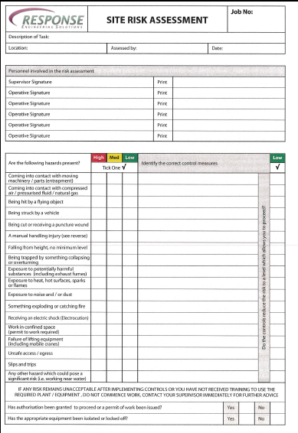
Risk Assessment
Notes:
A risk assessment is a document used to prove that we have assessed the risks of particular tasks before we start work.
A risk assessment is used to identify hazards (a hazard is anything with the potential to cause harm) and identify control measures to reduce the likelihood and severity of that hazard injuring you should something go wrong.
For example, a frequent hazard within a quarrying environment is workplace transport, control measures to minimise the risks of contact with workplace transport could be:
Flashing beacons on vehicles
Audible warnings when the vehicle is manoeuvering
Designated pedestrian walkways to segregate pedestrians and vehicles
Any risk assessment shall be ‘suitable and sufficient’ this means that control measures used shall be relevant and appropriate for the level of risk identified and also sufficient in terms of taking into account approved codes of practice, industry guidance and relevant legislation.

Slide 4
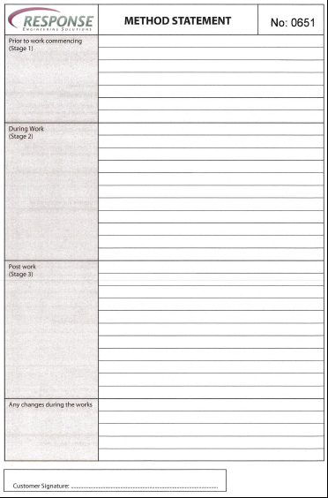
Method Statement
Notes:
A method statement is a written instruction detailing how the task is to be carried out. Within the method statement reference can be made to the risk assessment to reinforce the safest way to carry out the task.
The method statement can be broken down into critical stages of the task:
Prior to work commencing
During work
Post work
Any changes to the method statement identified during the task.
The method statement does not have to be highly detailed but it must highlight the key safety elements of any task.
The content of the risk assessment and method statement shall be discussed with all personnel involved and amendments made if necessary.
When finalised the risk assessment and method statement shall be signed by all personnel undertaking the task.

Slide 5
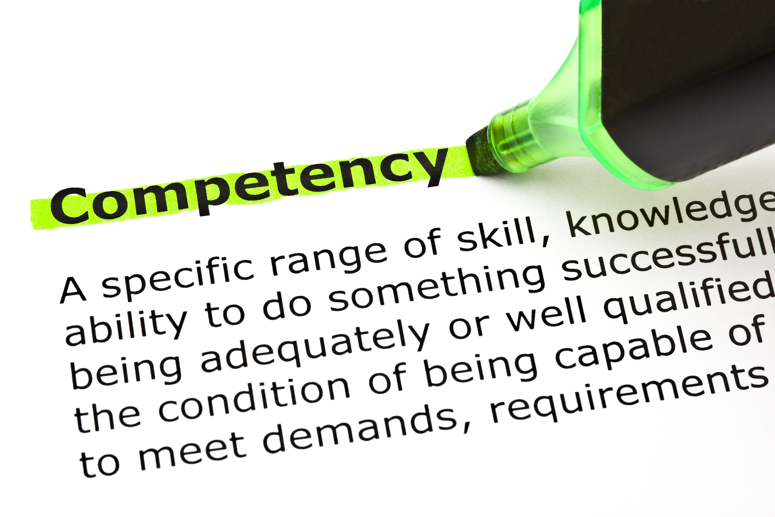
Quarry Contractors
Competency
Notes:
Most clients will want to see proof that people working on their site are competent. Items like Safety Passport cards, licences for various vehicles and trade specific qualifications shall be made available to the client on request. It is essential that only competent people are utilised.

Slide 6
Provision of Work Equipment
Ensure all work equipment is fit for use
This includes any machinery, appliance, apparatus or tool.
Examples include: hammers, knives, ladders, dumper truck, conveyor belt, crusher, weighbridge

Slide 7
Use of Work Equipment
Use of work equipment: This includes starting, stopping, erecting, installing, dismantling, programming, setting, using, transporting, repairing, modifying, maintaining, servicing and cleaning

Slide 8
Suitability of Work Equipment
An employer is required to :
Ensure that work equipment is suitable for the purpose for which it is used.
Selection of work equipment must have regard to working conditions and any additional risks posed by the use of the work equipment
The equipment must only be used for operations for which it is suitable.
Notes:
Any equipment used shall be included in a formal maintenance plan. Machinery and equipment shall be checked before use. Lifting equipment shall be inspected under the Lifting Operations and Lifting Equipment Regulations. Electrical equipment shall be PAT tested where appropriate. The relevant certification shall be available on request

Slide 9
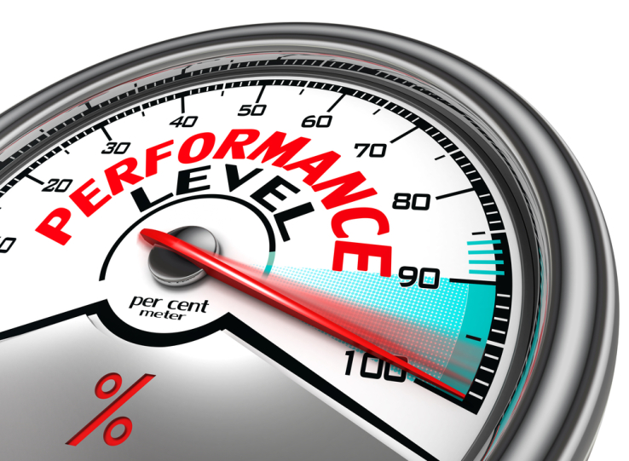
Performance Monitoring
Notes:
Performance Monitoring shall be used to confirm that your plans are working and that standards are being maintained and shall cover the following points:
Health and Safety – are the Risk Assessments and Method Statements being followed?, have relevant permits to work been issued where required?
Housekeeping - is the work area clear of slip/trip hazards? Are unsafe areas cordoned off to prevent access?
Competency, including delivery of toolbox talks and confirmation of site induction
Maintenance of work equipment including tools and vehicles
Accident recording and investigation
Ensure the results of the performance monitoring are passed onto your client and workforce. If remedial actions are required then make a plan with timescales and persons responsible clearly defined.

Slide 10
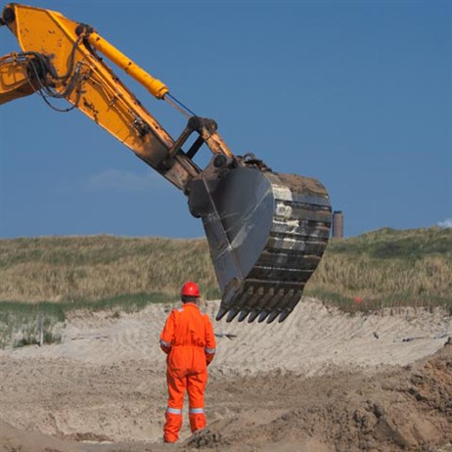
Accident Investigation
Investigate accidents/near misses
Notes:
All accidents and near misses shall be reported using the relevant company and client procedures.
Investigate all accidents and high potential near misses to identify immediate, underlying and root causes. Identifying corrective actions prevents the same scenario occurring again. It is just as important to investigate all of the near misses to an appropriate degree. When the investigation is complete you should hold a meeting with your client and team to discuss your findings and remedial actions. Depending on the findings it may be necessary to amend your risk assessment and method statement.

Slide 11
Be a good Role Model
As a contractor you will be under constant observation by your clients management and staff, make sure you lead by example at all times.
Have your Risk Assessment and Method Statement prepared and signed.
Wear all required PPE
Ensure you can prove competency
Ensure all equipment used is fit for purpose, included in a maintenance plan and has been checked prior to use
Notes:
As a contractor you will be under constant observation by your clients management and staff, make sure that you lead by example at all times
Have your RAMS prepared and signed
Wear all required PPE
Ensure you can prove competency if required
Ensure any equipment used is fit for purpose, included in a maintenance plan and has been checked prior to use

Slide 12
Be a good Role Model
Hold regular meetings with clients and staff to discuss performance monitoring and/or accident investigations.
Keep your work area and any welfare facilities tidy.
Maintain your standards
If you have any concerns, don’t be backward in coming forward!
Notes:
Hold regular meetings with clients and staff to discuss audit and/or accident investigations
Keep your work area and any welfare facilities tidy
Maintain your standards
If you have any concerns, don’t be backward in coming forward!

