Slide 1
LIFT TRUCK – STOP AND THINK
Narrated Briefing Slides – Version 3
March 2022
Notes:
<CLICK> to start

Slide 2
Notes:
Auto Start
Play video
Auto transition

Slide 3
Lift Truck – STOP AND THINK
Why should we do them?
What it is?
When should we do one?
How should we carry it out?
What do we do with the results?
Notes:
Narrator Script
Today we are going to look at Lift Truck – Stop & Think Assessments.
We are going to consider
Why should we do them?
What it is?
When should we do one?
How should we carry it out?
What do we do with the results?
Auto transition

Slide 4
Why a Dynamic Risk Assessment?
Because they prevent injuries and damage
Gives people the opportunity to take time before they do a job
Allows them to formally think about the risks and how they can be controlled
Lets people consult with others
It has been a legal requirement since 1992 to complete risk assessments and to record them
Notes:
Narrator Script
A Lift Truck – Stop and Think is a dynamic risk assessment, one that is done just before starting the job involving a Lift Truck
But why should we so a dynamic risk assessment?
<CLICK>
Most importantly because they help prevent injuries to people and damage to plant and equipment
<CLICK>
It gives people the opportunity to take time before they do a job to think what hazards may be present
It allows them to formally think about the risks and how these risks can be safely controlled
And it lets people consult with others that are involved or could be affected by the job
<CLICK>
Its also been a legal requirement since 1992 to complete risk assessments and record them
Auto transition

Slide 5
How do Brett undertake Risk Assessments?
Covered in QHEST BG1.3
Level 1 - Site level Risk Assessment
Level 2 - Task Based risk assessment
Level 3 - Permission to Proceed / Brettsafe / Lift Truck – Stop and Think
Notes:
Narrator Script
So how do we in Brett undertake risk assessments?
Well its covered in our QHEST Procedure BG1.3 and we have 3 levels of risk assessment
Firstly – the Level 1 Site level risk assessment which we do periodically and it looks at things at a high level across the whole site
Then we have the Level 2 – task based risk assessments, these are for specific and often our routine tasks and within Brett landscaping would normally have an associated Safe System of Work that goes with it.
Finally we have our Dynamic Risk Assessments such as Permission to Proceed and BrettSafes which can be used for any general task and our Lift Truck – Stop and Think assessment especially designed for assessing tasks involving use of Lift Trucks
Auto transition

Slide 6
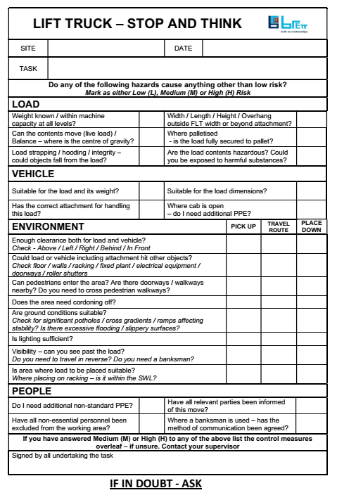
Why a Lift Truck – Stop and Think?
Because sometimes we need to undertake unusual or non-routine lifts of items or equipment
Because you’re the expert in that task - you can write down what you know happens & what you need to make it safe
Notes:
Narrator Script
So why do we have a specific Lift Truck Stop and Think?
<CLICK>
Because sometimes we need to undertake unusual or non-routine lifts of items or equipment
<CLICK>
Because you’re the expert in that task - you can write down what you know happens & what you need to make it safe
Auto transition

Slide 7
Why a Lift Truck – Stop and Think?
19% of all fatal Injuries in the Minerals industry are due to the fatal 6 category - Workplace Transport and Pedestrian interface
No-one wants you to get hurt, and you don’t want your colleagues to get hurt either
Damage to fixed or mobile plant, buildings and products all cost us time and money – both as operatives and the company
Notes:
Narrator Script
19% of all fatal Injuries in the Minerals industry are due to the fatal 6 category - Workplace Transport and Pedestrian interface
<CLICK>
Because no-one wants you to get hurt, and you don’t want your colleagues to get hurt either
<CLICK>
And Because damage to fixed or mobile plant, buildings and products all cost us time and money – both as operatives and the company
Auto transition

Slide 8
When should we do one?
All routine tasks should already have a Level 2 risk assessment
As a trained, competent and authorised lift truck user, you have been trained in the routine lifts that you undertake
However, sometimes you need to move or lift unusual / difficult loads, work in tight or confined areas, lift or travel where other people, equipment or trucks may also be working
When you are carrying out a non-routine task using a lift truck that doesn’t have an existing risk assessment use a ‘Lift Truck – Stop and think’
If you find that you are often carrying out a ‘Lift Truck – Stop and think’ for the same task then a full Level 2 risk assessment should be carried out
Notes:
Narrator Script
So when should we do a Lift Truck – Stop and Think?
<CLICK>
Well all routine tasks should already have a Level 2 risk assessment and as a trained, competent and authorised lift truck user, you have been trained in the routine lifts that you undertake
<CLICK>
However, sometimes you need to move or lift unusual / difficult loads, work in tight or confined areas, lift or travel where other people, equipment or trucks may also be working
<CLICK>
When you are carrying out a non-routine task using a lift truck that doesn’t have an existing risk assessment than use a ‘Lift Truck – Stop and think’ before you start the task
<CLICK>
And If you find that you are often carrying out a ‘Lift Truck – Stop and think’ for the same task then a full Level 2 risk assessment should be carried out
Auto transition

Slide 9
When should we use a Lift Truck – Stop and think?
Any time you think
I haven’t done this for a long time
When it doesn’t feel right – ‘I’m not sure about this’
I haven’t seen a Risk Assessment for this job
I have never done this before
I’m lifting a non-standard load
Working in tight areas close to others or fixed objects
Where other activities may affect that task I am doing
The weather conditions are different today (maybe hot, dry and dusty, or very wet and windy)
COMPLETE A
LIFT TRUCK – STOP AND THINK
Notes:
Narrator Script
So When should we use a Lift Truck – Stop and think?
Well any time you think
I haven’t done this for a long time
When it doesn’t feel right – ‘I’m not sure about this’
I haven’t seen a Risk Assessment for this job
I have never done this before
I’m lifting a non-standard load
Working in tight areas close to others or fixed objects
Where other activities may affect that task I am doing
The weather conditions are different today (maybe hot, dry and dusty, or very wet and windy)
<CLICK>
Then you should complete a Lift Truck – Stop and Think
Auto Transition

Slide 10
How do I fill one out?
For a start you need everyone involved in the task!
Consider whether there is an existing risk assessment for the job & if it is still valid
Is it sufficient or do you need to complete the Lift Truck – Stop and Think?
Fill out the detail of the job being done.
Notes:
Narrator Script
So how do I fill one out?
For a start you need everyone involved in the task!
Consider whether there is an existing risk assessment for the job & if it is still valid
Is it sufficient or do you need to complete the Lift Truck – Stop and Think?
Fill out the detail of the job being done.
Auto Transition

Slide 11
Let’s work through a Lift Truck – Stop and Think together
Think about a more unusual Lift Truck task that you to need do or have done recently
We will work through the Lift Truck - Stop and Think form taking each section at a time
You can work in pairs if you want so you can discuss and complete each section together
I will also take you through a Lift Truck task that I have assessed
When you have all decided what your tasks are then click on the continue Button
CONTINUE
Notes:
Narrator Script
So let’s work through a Lift Truck Stop and Think together
Think about a more unusual Lift Truck task that you to need do or have done recently
We will work through the Lift Truck - Stop and Think form taking each section at a time
You can work in pairs if you want so you can discuss and complete each section together
I will also take you through a Lift Truck task that I have assessed
When you have all decided what your tasks are then click on the continue Button
Set continue button to appear 30 secs after narration finishes

Slide 12
Header Section
Fill in the Site name, the date and briefly describe the task you are assessing
Notes:
Narrator Script
Firstly complete the header section with site name, the date and give a brief description of the task to be done and where it is to be done so we can identify it in the future.
Auto Transition

Slide 13
The Main Assessment
Now consider whether any of the following prompts are higher than a low risk?
Assess each hazard and mark whether the risk is Low (L), Medium (M) or High (H)
For each hazard that is Medium or High risk, the control measures must be listed on the reverse side of the form
Only continue with then job if you believe the overall risk of the task is Low – if it isn’t then talk to you supervisor about the job before you start the task
We need to consider
THE LOAD
THE VEHICLE
THE ENVIRONMENT at pick up point, whilst travelling and at place down point
THE PEOPLE
Notes:
Narrator Script
Once the header is completed we do the main assessment sections
Now consider whether any of the following prompts are higher than a low risk?
Assess each hazard and mark whether the risk is Low , Medium or High, using the first letter to mark which it is
Later on or the reverse of the form for each hazard that is either a Medium or High risk, thn the e control measures must be listed
Then only continue to do the job if you believe the overall risk of the task is Low – if it isn’t then talk to you supervisor about the job before you start the task
We need to consider the hazards
THE LOAD itself – what we are handling?
THE VEHICLE – we are going to use to do the job
THE ENVIRONMENT at pick up point, whilst travelling and at place down point
THE PEOPLE who maybe directly involved in the or affected by the job
Auto transition

Slide 14
How do I decide whether it’s a ‘low risk’?
A dictionary definition….
‘likely to be safe or without problems’
Notes:
Narrator Script
Okay, but how do I decide whether for a particular hazard that it’s a Low Risk?
Well a dictionary definition of low risk would be
Likely to b safe or without problems’
So consider whether this is the case - if it’s not true then it would be Medium or High Risk
Auto Transition

Slide 15
Let’s consider the Load Section
Notes:
Narrator Script
For each of the 6 questions consider whether it would
Low Risk
Medium Risk
High Risk
Use the first letter to indicate the level of risk
Let’s consider each question one at a time
Auto Transition

Slide 16
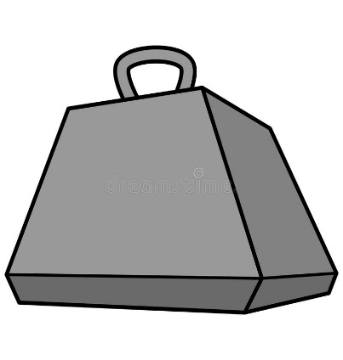
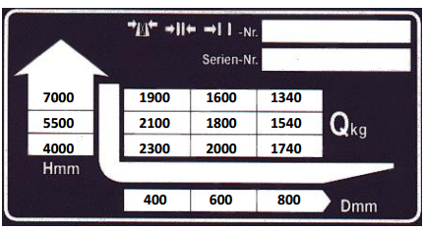
LOAD – Weight known & within the machine capacity at all levels ?
What is the weight of the item you are going to lift?
If unsure then check!
Is the load within the Safe Working Load of the Lift Truck?
Check this is the case at all positions you have to handle the load
If unsure check the Capacity Data Plate
?
Notes:
Narrator Script
Firstly consider whether the LOAD weight is known and within the Lift Truck capacity at all levels you are handling it.
What is the of the weight of the item going to be lifted? If you are unsure then check first
Then consider whether it is within the Safe Working load of the Lift Truck you are going to use
Make sure you check this is the case at all the positions you have to handle the load
If you are unsure then check the Lift Truck’s Capacity Data Plate which is within the cab
Auto Transition

Slide 17
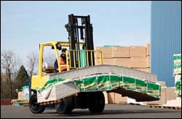
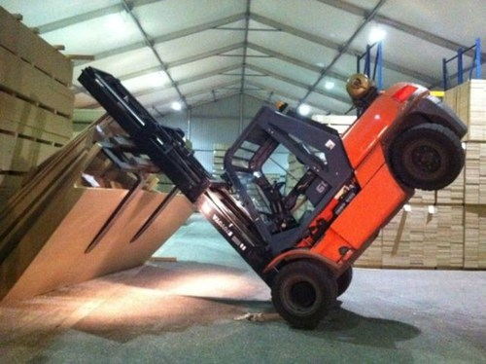
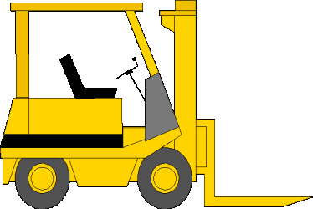
LOAD – Width / Length / Height / Overhang
Will to the load protrude beyond the lift truck and / or attachment dimensions
Is the load wider than the truck?
Is the longer than the attachment causing it to protrude beyond the attachment?
How high is the load?
This could affect visibility as well as clearance issues
Notes:
Narrator Script
Next you need to consider the width , length. Height of the load and whether there might be any over hang
Will to the load protrude beyond the lift truck and / or attachment dimensions?
Is the load wider than the truck? - do you need additional room to manoeuvre safely
Is the load longer than the attachment causing it to protrude beyond the attachment? Again you might need more clearance and may need to consider how stable the load will be and it might need additional securing and it could affect the centre of gravity of the combined truck and load
How high is the load? This could affect visibility as well as clearance issues to overhead structures etc
Auto Transition

Slide 18
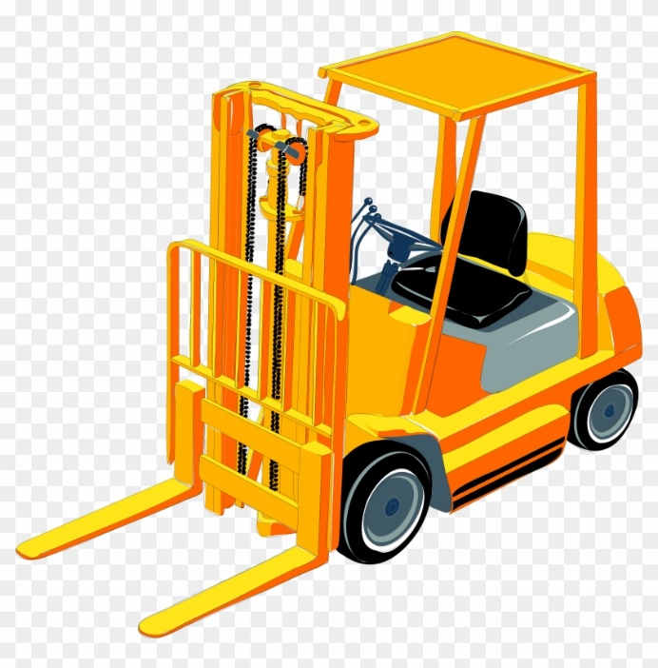
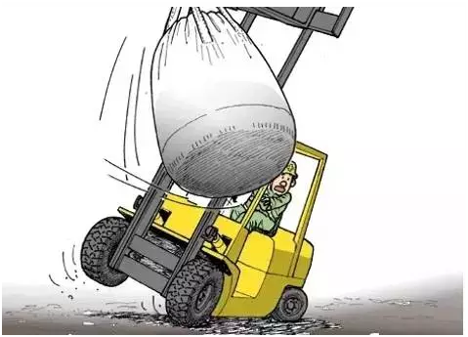
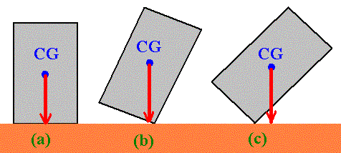
LOAD – It is Live or Unbalanced? Where is the Centre of Gravity?
Is the load Live – could it’s contents move causing a change in it’s centre of gravity?
Suspended loads or loose / liquid contents can cause then load’s centre of gravity to move
Is the load balanced?
Where is it’s centre of gravity?
50 kg
1500 kg
Notes:
Narrator Script
Next you need to consider the nature of the load itself – whether it could be a Live load or potentially unbalance dand where is its centre of gravity?
Is the load live i.e. could its contents move whilst it is being handled causing a change in its centre of gravity
This can happen with suspended loads or a load that has loose or liquid contents within it – as the contents move the load’s centre of gravity could move as well which can increase instability of truck and load
Consider whether the load is balanced – or is it heavier to one side
Always assess where the loads centre of gravity is and will it remain there as the load is handled?
Auto Transition

Slide 19
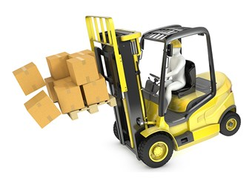
LOAD – Palletised Loads?
Is the load fully secured to the pallet?
If not, does it need to be strapped?
Could the load move on the pallet when lifted or travelling?
Will the load remain on the pallet if you have to brake hard?
Notes:
Narrator Script
You need to consider for palletised loads how secure the items are on the pallet itself
Is the load fully secured to the pallet itself – as your lifting and supporting the pallet but if the items on it are loose they could fall or drop off the pallet
If the load isn’t secure to the pallet you may need to consider additional strapping or hooding if the items could easily move
Consider whether the load itself could move on the pallet itself whilst lifting it or travelling and consider whether the load would remain on the pallet if you had to brake hard.
Auto Transition

Slide 20
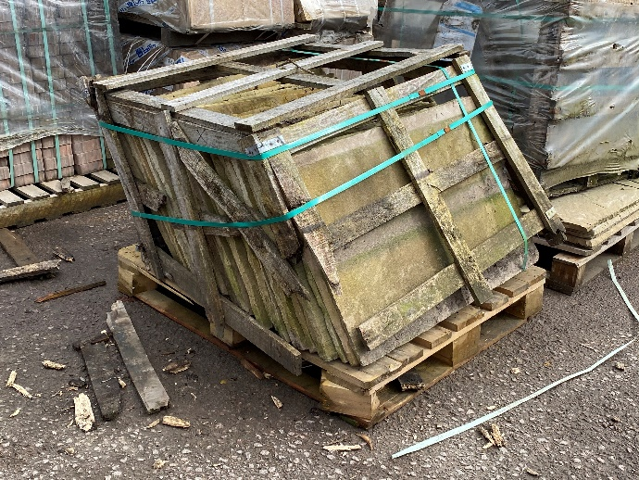
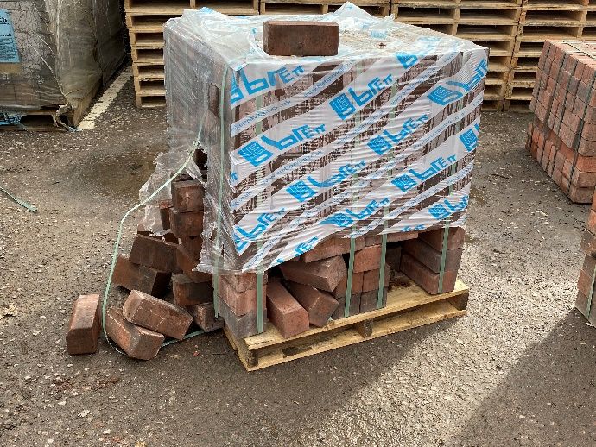
LOAD – Is it fully secure?
Is load strapping / hood or wrap or bulk bag / IBC in good condition?
Especially product packs – is the integrity of the strapping and / or wrap adequate for the whole lift, travel and place down?
Will the load still be secure if it has to be moved again by someone else?
Could part of the load fall?
Does it need to placed on a pallet before travelling?
Notes:
Narrator Script
Not all our products are palletised and sometimes there are issues even with palletised load – regardless of whether the load is palletised always consider whether it is fully secure – throughout the whole of the handling operation and then afterwards where it is stored or if others have to handle it later
Consider whether the
load strapping / hood or wrap or bulk bag / IBC in good condition? Especially for product packs – is the integrity of the strapping and / or wrap adequate for the whole lift, travel and place down?
Will the load still be secure if it has to be moved again by someone else?
Could part of the load fall whilst handling it and especially think whether others could be injured by falling or moving objects, one of the fatal 6
Does it need to placed on a pallet before travelling to make it more secure?
Auto Transition

Slide 21
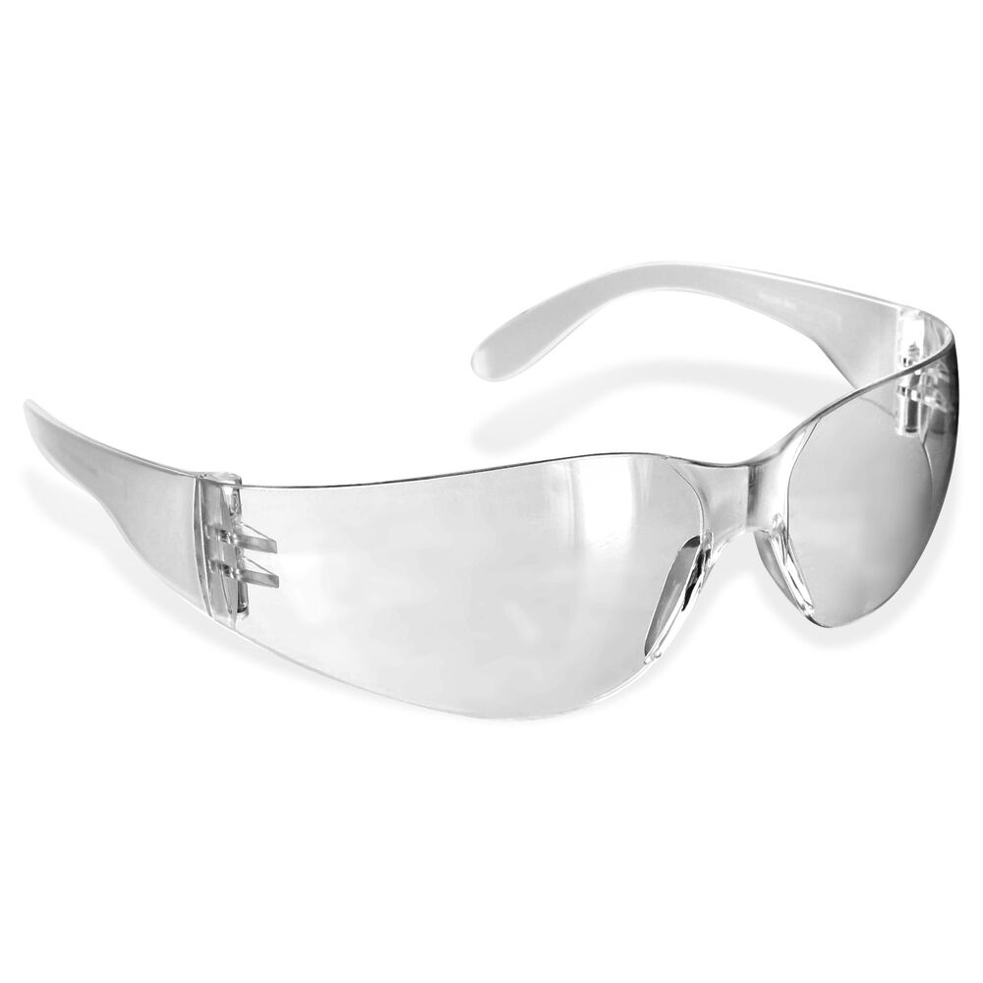
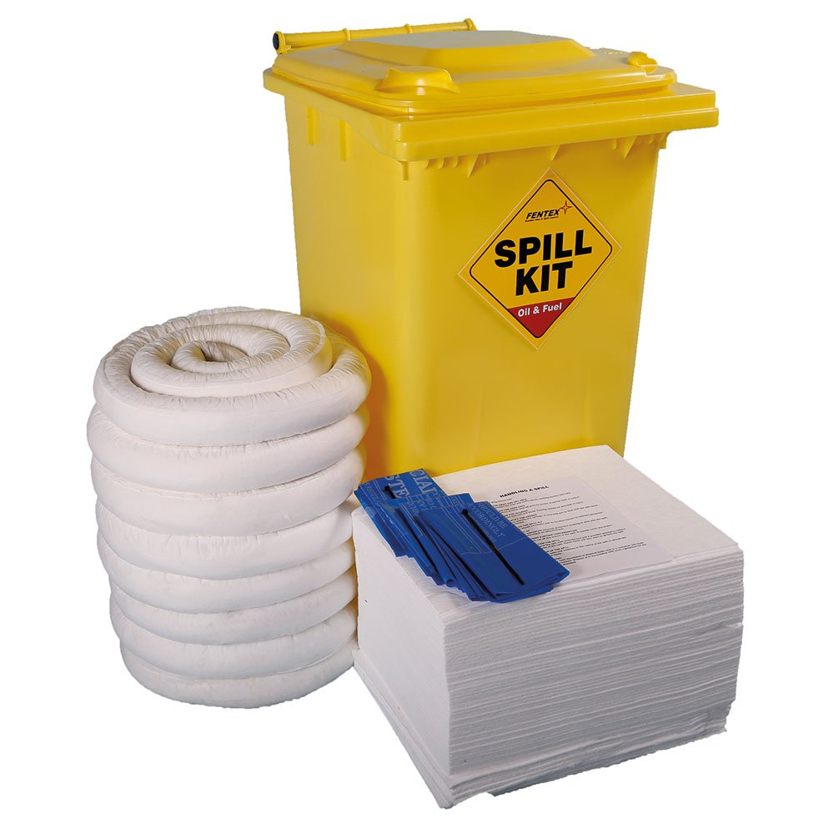
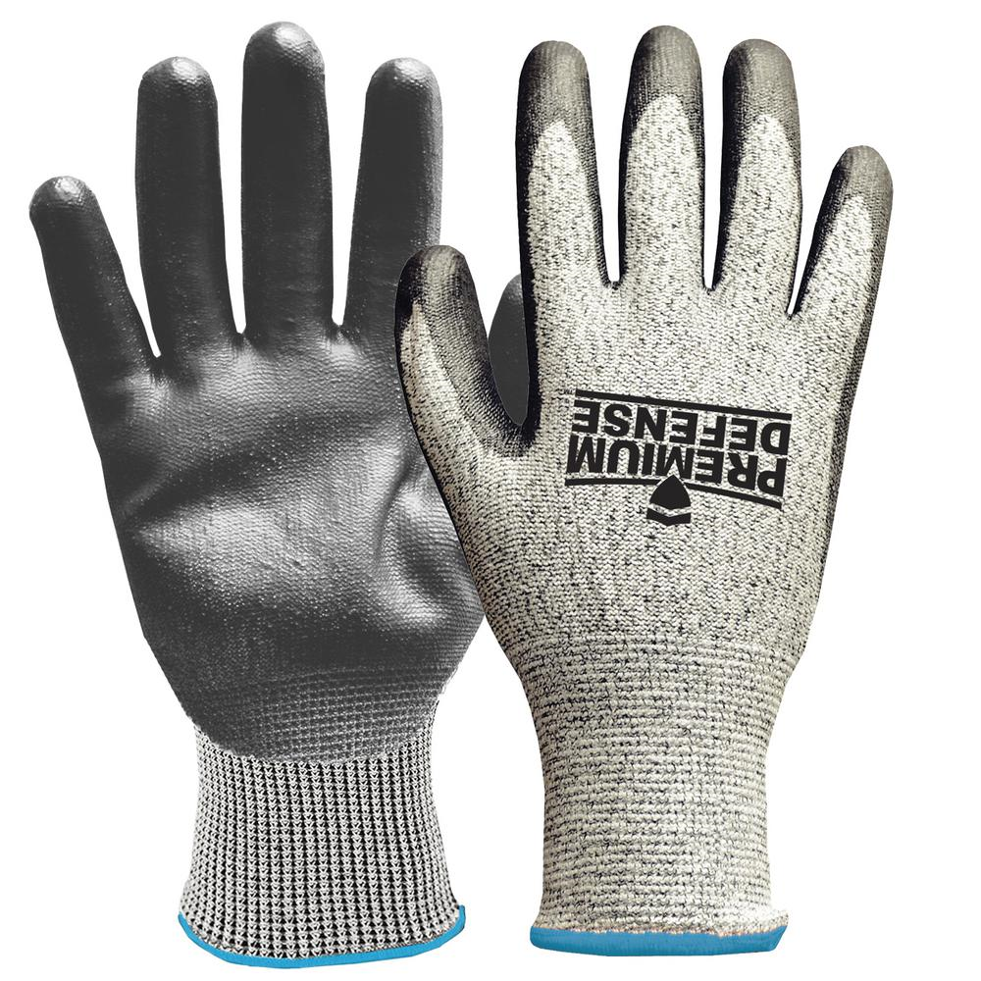
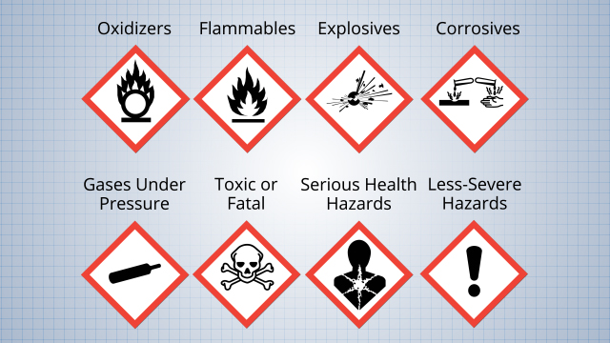
LOAD – are the load contents Hazardous?
Do you know if the load contains any hazardous substances?
Could these effect you, others or the environment?
Do you need to check the COSHH Assessment?
What PPE might be needed beyond what is standard requirements?
If is spilt – what are the emergency spill procedures for these substances?
Notes:
Narrator Script
Lastly for the load think about whether the contents are hazardous substances which can effect you or others
Do you know if the load contains any hazardous substances?
Could these effect you, others or the environment? You may need to check the COSHH Assessment
Consider what PPE might be needed beyond what is standard Brett requirements?
If any hazardous substances are spilt then what are the emergency spill procedures for these substances?
Auto Transition

Slide 22
LOAD Hazards
Now we been together through each of the Load questions, complete the Load Section for the Lift Truck task you are assessing to decide whether the hazard is Low (L), Medium (M) or High (H) risk
When everyone has done this press the continue button move on
CONTINUE
Notes:
Narrator script
Now we been together through each of the Load questions, complete the Load Section for the Lift Truck task you are assessing to decide whether the hazard is Low, Medium or High risk
When everyone has done this press the continue button move on
Person leading the TBT <CLICK>s to advance slide

Slide 23
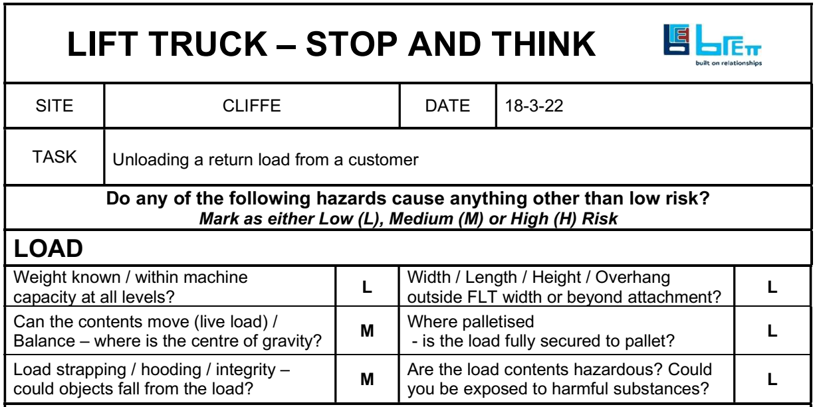
LOAD Hazards
The task I am assessing is unloading a return load from a customer, so my completed Load section looks this
Notes:
Narrator Script
So how did you get on?
The task I am assessing is xxxxxxxxxxx (brief description of the task)
I assessed
Yyyyy as Medium (or High) because ………..
or
For this task I assessed all the hazards as Low – being likely to be safe or without problems
Lets move on to consider the Vehicle Hazards
auto transition

Slide 24
Let’s consider the Vehicle Section
Notes:
Narrator Script
For each of the 4 questions consider whether it would be Low, Medium or High Risk
Let’s consider each question one at a time
Auto Transition

Slide 25
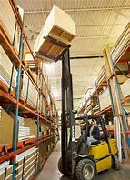
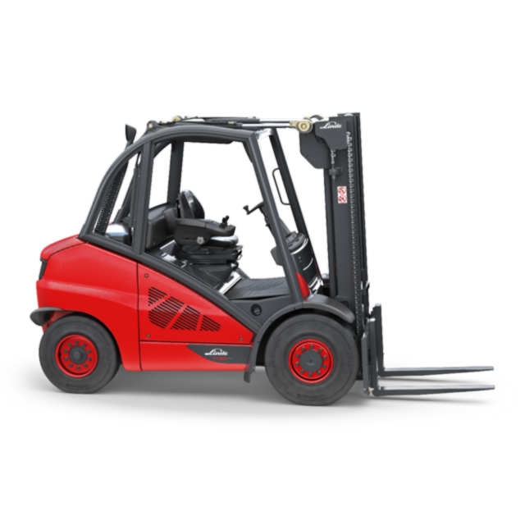
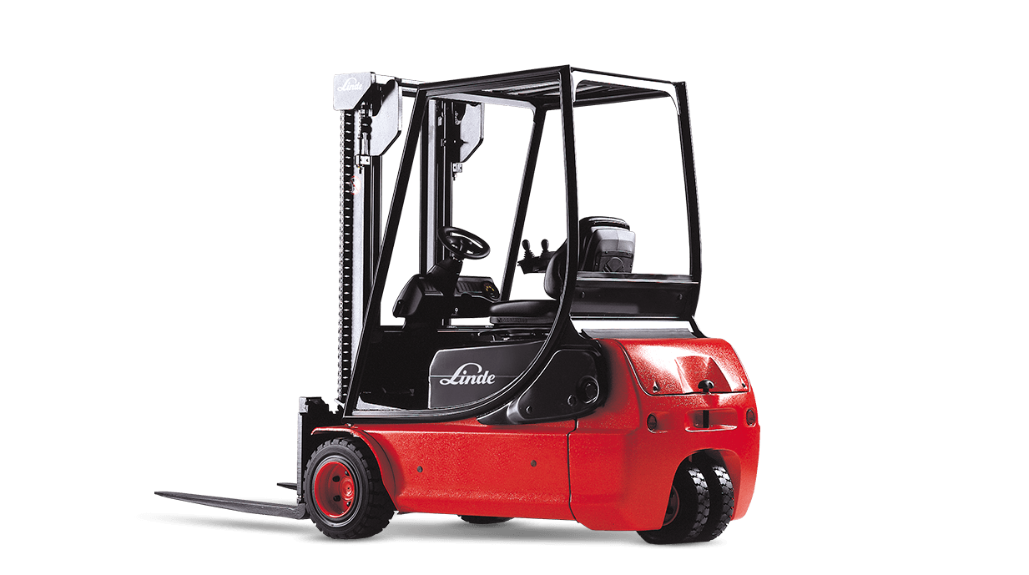
VEHICLE - Suitable for the load weight?
?
Is this the correct lift truck to handle the load?
Weight of the load?
Enough reach?
At all pick up / travel / place down points?
?
Notes:
Narrator Script
Firstly we need to consider whether the Lift Truck is suitable for the load weight – i.e., is it the correct lift truck to handle this load?
Will it handle the weight of the load?
Does it have sufficient reach – at the pick up point, whilst travelling and also at the place down point?
Auto Transition

Slide 26
VEHICLE - Suitable for the load dimensions?
Is this the correct lift truck to handle the load?
Width of load?
Length of load?
Height of load?
?
?
?
Notes:
Narrator Script
Is the Lift truck suitable for the load dimensions?
Can it safely handle the width, length and height of the load to be moved.
Auto Transition

Slide 27
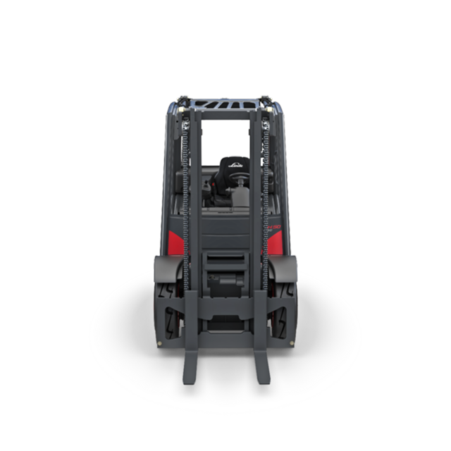
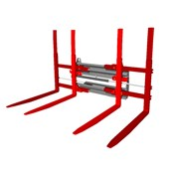
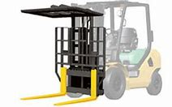
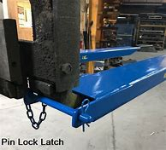
VEHICLE - is this truck fitted with the correct attachment to handle the load?
Is this the correct truck attachment to handle the load?
Does it need single forks or double forks?
Do I need fork extensions?
Do fork positions need to altered to suit the load?
Could parts of attachment foul the load or other equipment
i.e. top clamp?
Notes:
Narrator Script
Now you need to consider whether the truck is fitted with the correct type of attachment to handle the load?
Does it need single forks or double forks?
Do you need fork extensions?
Do the fork positions need to altered to suit the load?
Could parts of attachment foul the load or other equipment – i.e. when top clamp is fitted as well as forks?
Auto Transition

Slide 28
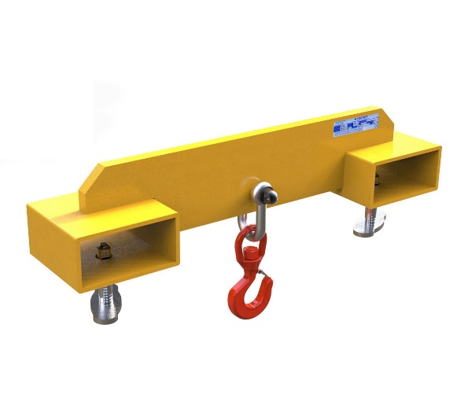
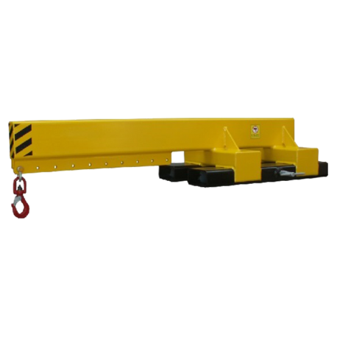
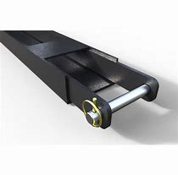
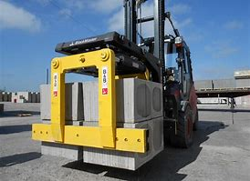
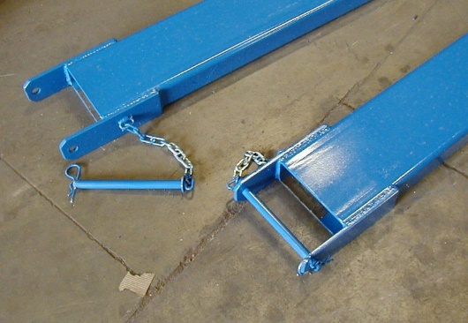
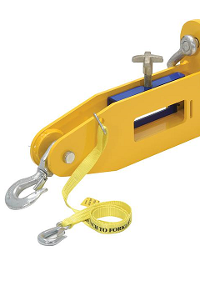
VEHICLE - is this truck fitted with the correct attachment to handle the load? Continued
Is this the correct lift truck attachment to handle the load?
Do I need a grab attachment to grip the load?
Do I need a lifting beam and hook to suspend the load?
Is the capacity of any attachment sufficient for the load weight?
How will I secure the attachment if not permanently fitted?
SWL?
Notes:
Narrator script
Other things to consider when assessing if it is the correct attachment to handle the load include
Do you need a grab attachment to grip the load?
Do you need a lifting beam and hook to suspend the load? – remember to use this the person slinging must be trained and competent to sling loads under LOLER
Is the capacity of any attachment sufficient for the load weight?
How will I secure the attachment if not permanently fitted?
Auto Transition

Slide 29
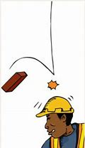
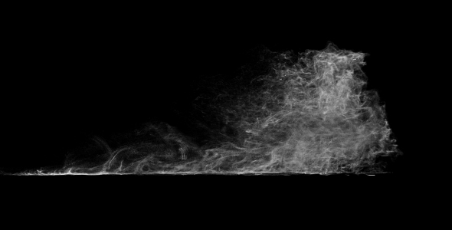
VEHICLE - is the cab open?
Where the lift truck has an open cab consider whether it is suitable for this task?
Could debris / objects fall into the cab?
Could I be affected by wind-blown dust?
Could I be splashed by chemicals or hazardous material?
Do I need additional PPE for the task?
Notes:
Narrator Script
Finally you need to consider whether the lift truck cab is open sided
Where the lift truck has an open cab consider whether it is suitable for this task?
Could debris / objects fall into the cab?
Could you be affected by wind-blown dust?
Could you be splashed by chemicals or hazardous material?
Do you need any additional PPE for the task?
Auto transition

Slide 30
VEHICLE Hazards
Now we been together through each of the Vehicle questions, complete the Vehicle Section for the Lift Truck task you are assessing to decide whether the hazard is Low (L), Medium (M) or High (H) risk
When everyone has done this press the continue button move on
CONTINUE
Notes:
Narrator script
Now we been together through each of the vehicle questions, complete the Vehilce Section for the Lift Truck task you are assessing to decide whether the hazard is Low, Medium or High risk
When everyone has done this press the continue button move on
Person leading the TBT <CLICK>s to advance slide

Slide 31
VEHICLE Hazards
The task I am assessing is unloading a return load from a customer, so my completed Load section looks this
Notes:
Narrator Script
So how did you get on?
The task I am assessing is xxxxxxxxxxx (brief description of the task)
I assessed
Yyyyy as Medium (or High) because ………..
or
For this task I assessed all the hazards as Low – being likely to be safe or without problems
Lets move on to consider the Environment Hazards
auto transition

Slide 32
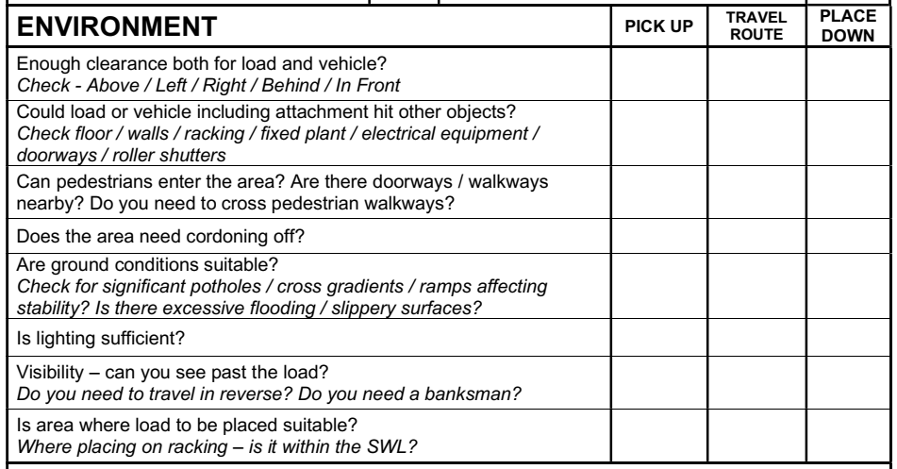
Let’s consider the Environment Section
For each question you must consider how the Environment you will be working in affects the task, when you pick up the load, travelling with it and placing it down.
Notes:
Narrator Script
For each question you must consider how the Environment you will be working in affects the task, when you pick up the load, travelling with it and placing it down.
For each of the 8 questions consider whether it would be Low, Medium or High Risk at the
Pick up point
Along the travel route, and
At the place down point
Let’s consider each question one at a time
Auto Transition

Slide 33
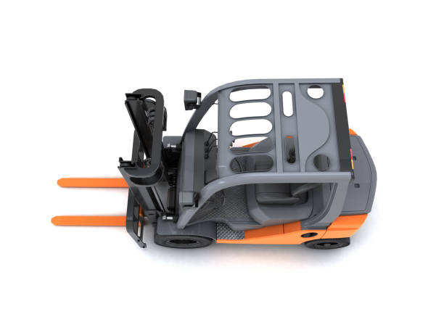
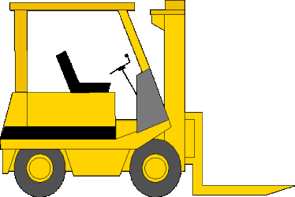
ENVIRONMENT – Enough clearance for both the load and truck?
Is there enough clearance around the truck and load?
On load pick up, on the travel route and on load place down?
LEFT
ABOVE
LOAD
BEHIND
IN
FRONT
RIGHT
Notes:
Narrator Script
Firstly consider whether there is enough clearance for both the load and truck, when picking it up, whilst travelling with it and where you are going to place it down.
Always check
To the left
To the right
Behind the truck
In Front of the truck
Above the load
Auto Transition

Slide 34
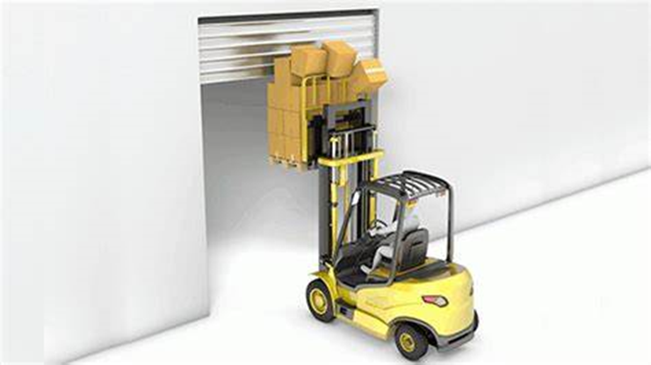
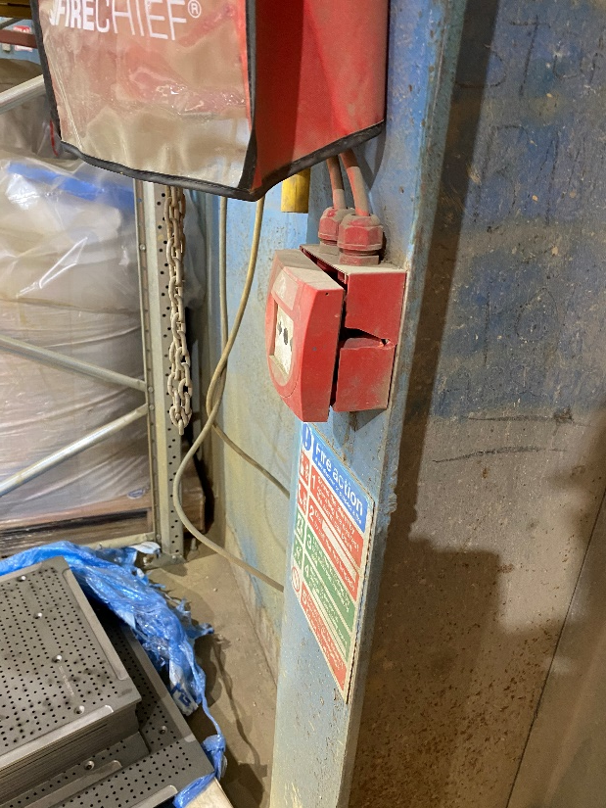
ENVIRONMENT – Could Load or attachments hit other objects?
Things to consider during Pick up / Travel route / Place down
Floor condition
Walls
Racking
Fixed plant
Other mobile plant
Electrical equipment, fixtures, panels
Doorways
Roller shutter doors
Notes:
Narrator Script
It vital to consider whether the load, truck or attachments hit other objects during the Pick up, on the travel route and at the place down point
This is especially important when working in tighter or restricted areas
Take into account and consider
Floor condition – could it affect the load handling
Walls, Racking and Fixed plant – is there sufficient clearance?
Is other mobile plant in the area? Whether moving or parked up – could there be a collision?
Always consider any Electrical equipment, fixtures, panels in the area – these often protrude out from walls or columns
Doorways and Roller shutter doors – is there sufficient clearance both sides – and is the roller shutter fully retracted and will your truck and load pass safely under it?
Auto Transition

Slide 35
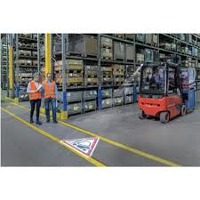
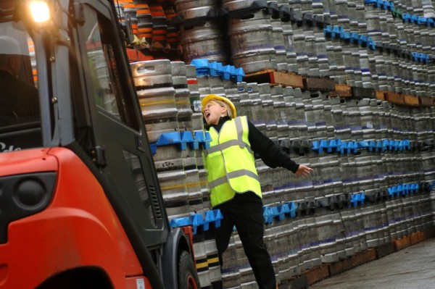
ENVIRONMENT – Can pedestrians enter the area or travel route?
Things to consider during pick up / travel route / Place down
Do you need to cross a walkway?
Do you need to pass a doorway?
Do you need to travel in an area normally reserved for pedestrians?
Notes:
Narrator Script
It vital that you consider whether pedestrians could entee the area you are working in or along the travel route you will pass.
Remember 57% of people injured in fork lift truck incident were pedestrians not the truck driver.
Things to consider during the pick up, along the travel route and at the Place down point
Do you need to cross a pedestrian walkway?
Do you need to pass a pedestrian doorway?
Do you need to travel in an area normally reserved for pedestrians?
Auto Transition

Slide 36
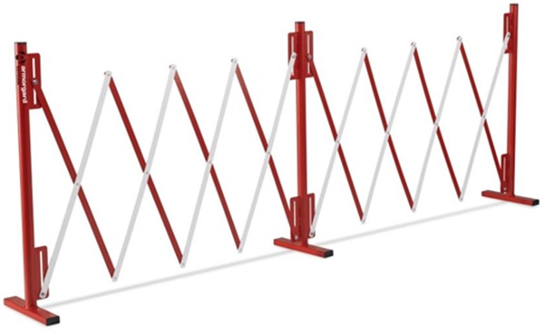
ENVIRONMENT – Does the area need cordoning off?
If you have to cross a walkway do you need to cordon it off during the lift?
If you have to pass close to a door where pedestrians can suddenly appear, do you need to stop pedestrian access temporarily?
Notes:
Narrators Script
Consider whether any of the areas you are working in need cordoning off
If you have to cross a walkway do you need to cordon it off during the lift?
If you have to pass close to a door where pedestrians can suddenly appear, do you need to stop pedestrian access temporarily?
Auto Transition

Slide 37
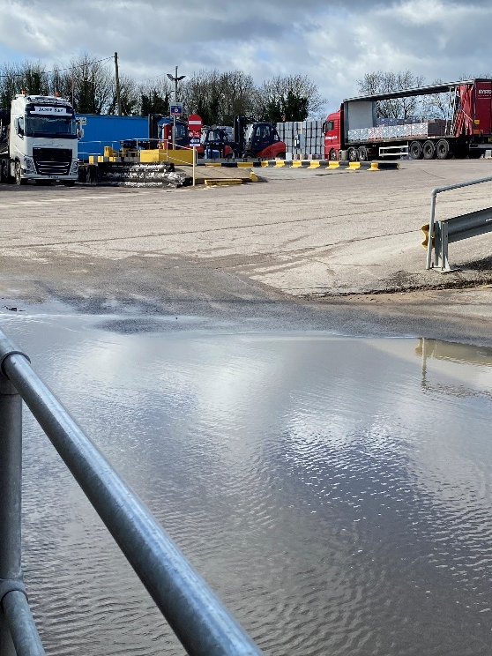
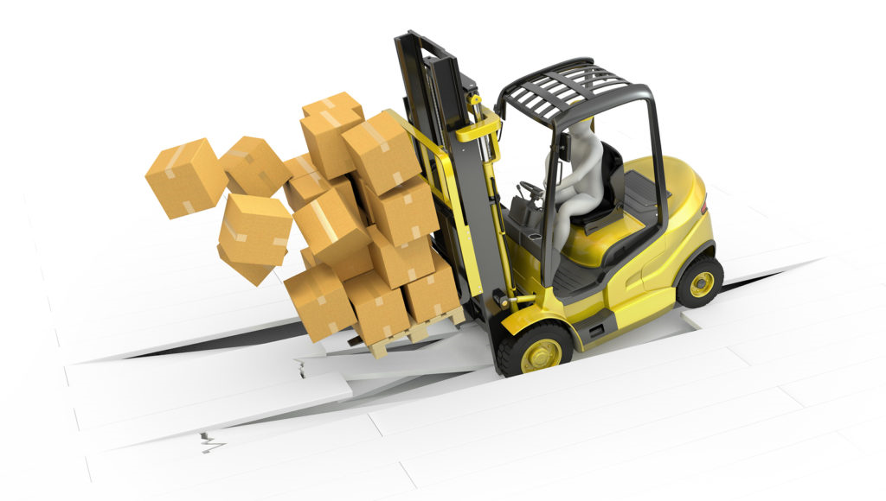
ENVIRONMENT – Are ground conditions suitable?
Check for overall ground condition of the pick up, travel route and place down area.
Look for conditions that could effect stability, such as
Potholes
Cross gradients
Ramps
Soft ground
Also check for excessive flooding and slurry build up that could effect grip and possibly hide potholes and debris effecting stability.
Notes:
Narrators Script
Now you need to consider whether the ground conditions are suitable at the pick up point, along the travel route and at the place down area
Look for conditions that could effect stability, such as
Potholes
Cross gradients
Ramps
Soft ground
Also check for excessive flooding and slurry build up that could effect grip and possibly hide potholes and debris effecting the stability of both the load and the truck.
Auto trnsition

Slide 38
ENVIRONMENT – Is the lighting sufficient?
Consider the lighting at all points of the lift
Pick up
Travel route
Put down point
Do you need extra temporary lighting to complete the lift safely?
Notes:
Narrators Script
You also need to consider whether the lighting is sufficient at all points during the task, at the pick up point, along the travel route and at the put down point.
Your truck may have its own lights that supplement any area lighting, but consider whether you need extra temporary lighting to complete the lift safely
Auto transition

Slide 39
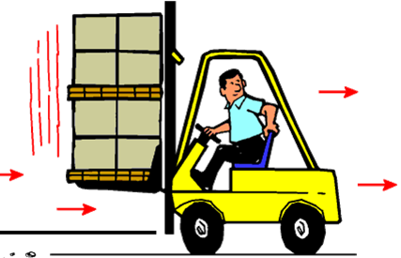
ENVIRONMENT Visibility - Can you see past the load?
If visibility past the load is restricted, do you need to consider direction of travel?
Would travelling backwards during the lift present greater risks the you need to consider?
Would a banksman be effective in reducing the risks?
Notes:
Narrator Script
Next think about whether you can see past the load
If visibility past the load is restricted, do you need to consider direction of travel?
Would travelling backwards during the lift present greater risks the you need to consider?
Would a trained and competent banksman be effective in reducing the risks?
But you must also consider whether there will be sufficient room for a banksman to safely direct you without them being put in a place of danger
Auto transition

Slide 40
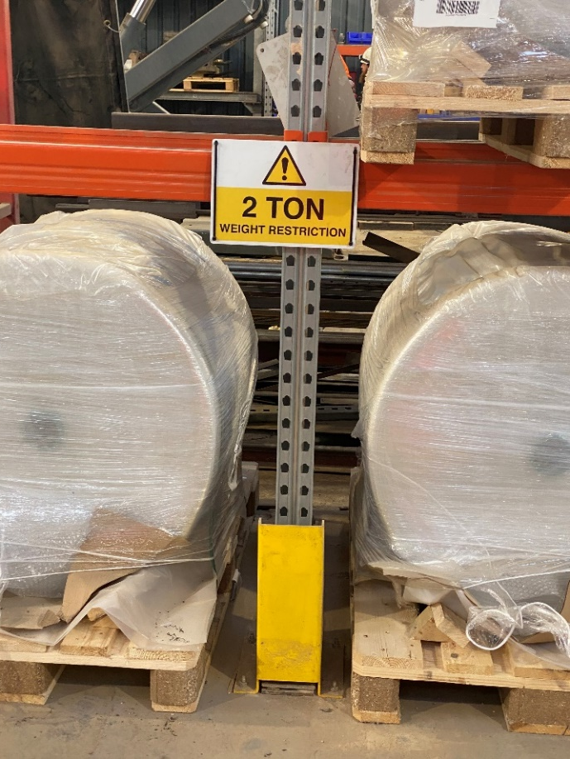
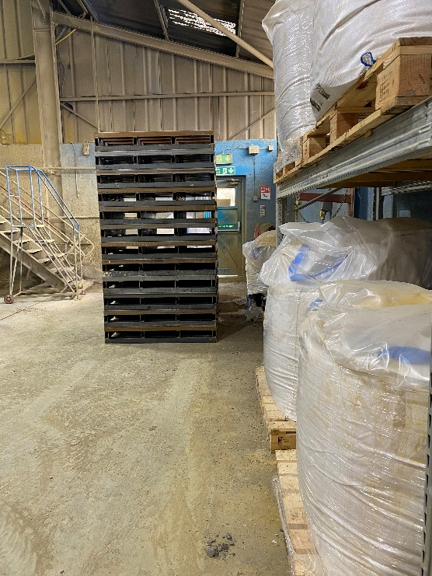
ENVIRONMENT – Is the location of the place down suitable?
If placing onto a rack is the load within the safe working load of the rack and is there enough space?
If put down on the floor, will its position create further risks such as blocking walkways, fire exits or machinery?
Notes:
Narrator script
Finally in the Environment section consider whether the location of the place down suitable to put this load
If placing the load onto a rack - is the load within the safe working load of the rack, taking into account any loads already on the rack and is there enough space in the rack for this load
If putting it down on the floor, consider whether its position will create further risks such as blocking pedestrian walkways, fire exits or access to other machinery or restrict other lift trucks working areas?
Auto transition

Slide 41
ENVIRONMENT Hazards
When everyone has done this press the continue button move on
CONTINUE
Notes:
Narrator script
Now we been together through each of the environment questions, complete the environment Section for the Lift Truck task you are assessing to decide whether the hazard is Low, Medium or High risk
Do this for each hazard at the
Pick up point
Along the travel route
And at the place down point
When everyone has done this press the continue button move on
Person leading the TBT <CLICK>s to advance slide

Slide 42
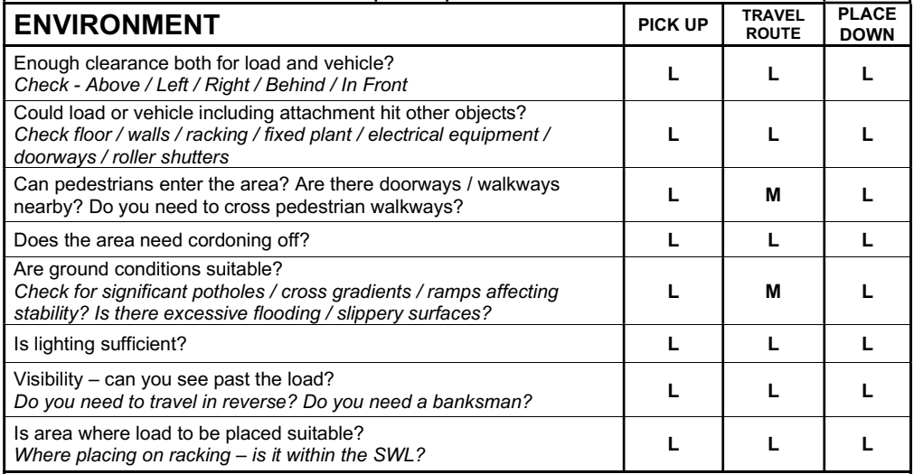
ENVIRONMENT Hazards
The task I am assessing is unloading a return load from a customer, so my completed Environment section looks this
Notes:
Narrator Script
So how did you get on?
The task I am assessing is xxxxxxxxxxx (brief description of the task)
I assessed
Yyyyy as Medium (or High) because ………..
or
For this task I assessed all the hazards as Low – being likely to be safe or without problems
Lets move on to consider the People Hazards
auto transition

Slide 43
Let’s consider the People Section
For each question you must consider how People may be affected by this lift truck
Notes:
Narrator Script
For each question you must consider how People may be affected by this lift truck
Let’s consider each question one at a time
Auto Transition

Slide 44
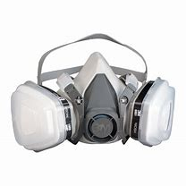
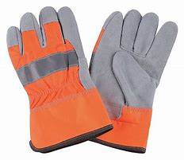
PEOPLE – do I need additional PPE?
Does the load present the need for additional PPE from the normal?
Risk of powder / liquid spillage?
Dangerous substances?
Open or closed cab?
Notes:
Narrator Script
Firstly consider whether you need any additional PPE?
Does the load present the need for additional PPE from the normal?
Risk of powder / liquid spillage?
Dangerous substances?
Open or closed cab?
Auto Transition

Slide 45
PEOPLE – have all the relevant parties been informed?
Have all the people that could be effected by the lift and travel been informed?
Have all the people involved been briefed on the plan?
Has the communication system been tested
and all informed of the words of instruction to be used?
Notes:
Narrator Script
Next consider whether all the relevant parties have been informed
Have all the people that could be effected by the lift and travel been informed?
Have all the people involved been briefed on the plan?
Has the communication system been tested and all informed of the words of instruction to be used?
Auto Transition

Slide 46
PEOPLE – Have all non-essential personnel been excluded from the working area?
Have all people not involved been cleared from the area for the duration of the lift reducing their exposure to danger?
Notes:
Narrator Script
Have all non-essential personnel been excluded from the working area?
Do all people not involved in the lift truck task need to be cleared from the area for the duration of the lift reducing their exposure to danger
You may need additional signage or barrier tape
Auto Transiton

Slide 47
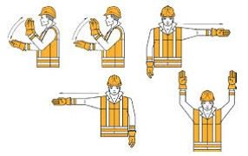
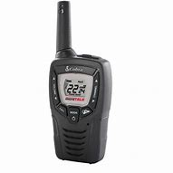
PEOPLE – Where a banksman is used has a method of communication been agreed?
How will you communicate?
Verbal?
Radio?
Hand signals?
Notes:
Narrator Script
Finally, where a trained and competent banksman will be used has the method of communication been agreed between the lift truck operator and the banksman?
Will this be
Direct Verbal
Via a Radio
Using defined Hand signals – both the banksman and the lift truck operator must be familiar with the hand signals.
Auto Transition

Slide 48
People Hazards
Now we been together through each of the People questions, complete the People Section for the Lift Truck task you are assessing to decide whether the hazard is Low (L), Medium (M) or High (H) risk
Remember that everyone undertaking this task should sign the assessment
When everyone has done this press the continue button move on
CONTINUE
Notes:
Narrator script
Now we been together through each of the people questions, complete the people Section for the Lift Truck task you are assessing to decide whether the hazard is Low, Medium or High risk
Remember that everyone undertaking this task should sign the assessment
When everyone has done this press the continue button move on
Person leading the TBT <CLICK>s to advance slide

Slide 49
PEOPLE Hazards
The task I am assessing is unloading a return load from a customer, so my completed People section looks this
Notes:
Narrator Script
So how did you get on?
The task I am assessing is xxxxxxxxxxx (brief description of the task)
I assessed
Yyyyy as Medium (or High) because ………..
or
For this task I assessed all the hazards as Low – being likely to be safe or without problems
Lets move on to consider the People Hazards
auto transition

Slide 50
What if you have assessed any of the headings as Medium (M) or High (H) Risk?
For your Lift Truck Stop and Think – list down all the hazards you have assessed as Medium or High on the Control Measures page
You need to decide, record down and then put in place all the control measures necessary to reduce the risk before starting the task
You then need to consider what the residual risk is now with these control measures in place and record it in the last column
When everyone has done this press the continue button move on
CONTINUE
Notes:
Narrators script
What if you have assessed any of the headings as Medium (M) or High (H) Risk?
For your Lift Truck Stop and Think – list down all the hazards you have assessed as Medium or High on the Control Measures page
You need to decide, record down and then put in place all the control measures necessary to reduce the risk before starting the task
You then need to consider what the residual risk is now with these control measures in place and record it in the last column
When everyone has done this press the continue button move on
Person leading the TBT <CLICK>s to advance slide

Slide 51
Control Measures
The task I am assessing is unloading a return load from a customer, so my completed Load section looks this
Notes:
Narrator script
So how did you get on?
The task I am assessing is xxxxxxxxxxx (brief description of the task) the hazards that where assessed as Medium or High risk were
Xxxxxx and I have out in place additional controls including yyyyy which once in place reduce the residual risk to LOW
Etc

Slide 52
What if even after I have applied the additional control measures it is still not LOW risk?
If unsure about anything
or
you cannot get the risk to LOW
Contact your supervisor.
Notes:
Narrator Script
What if even after I have applied the additional control measures still is not LOW risk
If unsure about anything or you cannot get the risk to LOW even when you have applied the additional controls than Contact your supervisor.

Slide 53
Discussion
Now you have completed your Lift Truck – Stop and Think
Discuss your assessment and the recommended controls with the others in this this training group or discuss it with your supervisor
When everyone has done this press the continue button move on
CONTINUE
Notes:
Narrator Script
Now you have completed your Lift Truck – Stop and Think
Discuss your assessment and the recommended controls with the others in this this training group or discuss it with your supervisor
When everyone has done this press the continue button move on
Person leading the TBT <CLICK>s to advance slide

Slide 54
What should I do with my completed Lift Truck – Stop and Think assessments?
You should hand your completed Lift Truck – Stop and Think assessments to your supervisor.
They will review them before passing onto the site office to be kept
Each site reports weekly the number of Lift Stop – Stop and Thinks done as part of their weekly SHE return
If the same task is repeatedly having a Lift Truck – Stop and Thank assessment then your supervisor will undertake a full level 2 risk assessment and develop a SSOW
Notes:
Narrator Script
So what should I do with my completed Lift Truck – Stop and Think assessments once I have complete them and the task?
You should hand your completed Lift Truck – Stop and Think assessments to your supervisor.
They will review them before passing onto the site office to be kept
Each site reports weekly the number of Lift Stop – Stop and Thinks done as part of their weekly SHE return
If the same task is repeatedly having a Lift Truck – Stop and Thank assessment then your supervisor will undertake a full level 2 risk assessment and develop a SSOW
Auto transition

Slide 55
Conclusion
So use your Lift Truck Stop and Think whenever things are different to normal routine task such as
Different truck or unusual load
Where there isn’t an existing RA/SSOW available
Working in a restricted or tight area
Where other activities may be being undertaken in the same area
When you are unsure
It won’t take long to consider the hazards, assess the risks and identify any additional controls
Notes:
Narrator Script
So use your Lift Truck Stop and Think whenever things are different to normal routine task such as
Different truck or unusual load
Where there isn’t an existing RA/SSOW available
Working in a restricted or tight area
Where other activities may be being undertaken in the same area
When you are unsure
It won’t take long to consider the hazards, assess the risks and identify any additional controls
Auto Transition

Slide 56
Conclusion
So use your Lift Truck Stop and Think
It keeps you and others safe.
It will help you spot the risks you have not considered before.
IF IN DOUBT STOP AND ASK
Notes:
Narrator Script
So use your Lift Truck Stop and Think
It keeps you and others safe.
It will help you spot the risks you have not considered before.
IF IN DOUBT STOP AND ASK
Auto Transition – 10 seconds after end of narration

Slide 57
Thank you for your time.
Any Questions ?
Notes:
Narrator Script
Thank you for your time.
If you have Any Questions – speak with today’s TBT facilitator or with your line manager or supervisor

