Slide 1
Replacing Face Top Edge Protection.
Whatley Quarry
Whatley
Nr. Frome
Somerset
BA112EU

Slide 2
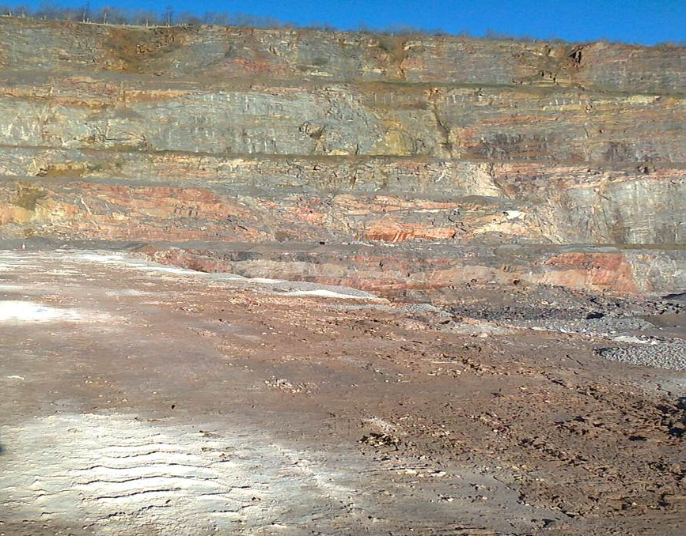
The Unprotected Crest - Post Blast

Slide 3
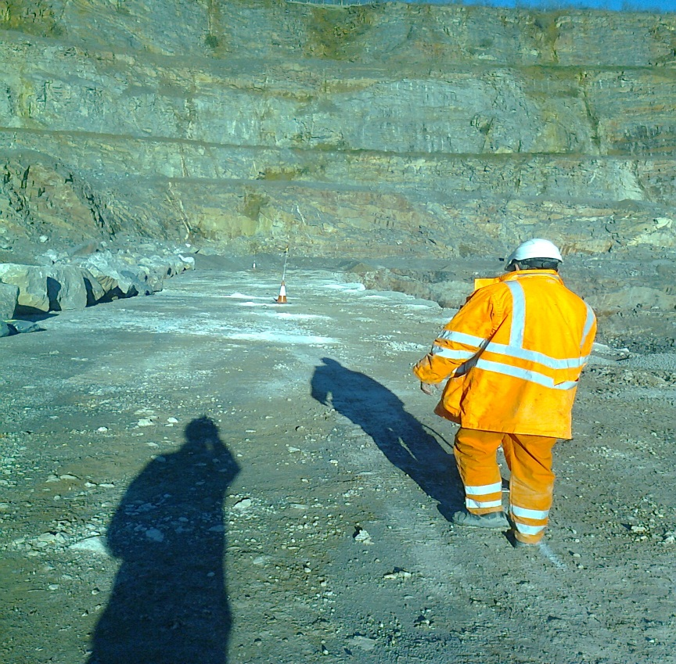
Determine the Standoff
The distance the stand off must be from the crest is to be assessed and defined based on the information contained in the post blast inspection relayed from the shot firing team. This has to be a minimum of 5m.
It is essential that this information be passed on to the FEL driver.
The person carrying out this task must have undergone Geotechnical training to a minimum of EPIC level 3
A weighted line can then be used to mark out the predetermined distance from the crest

Slide 4
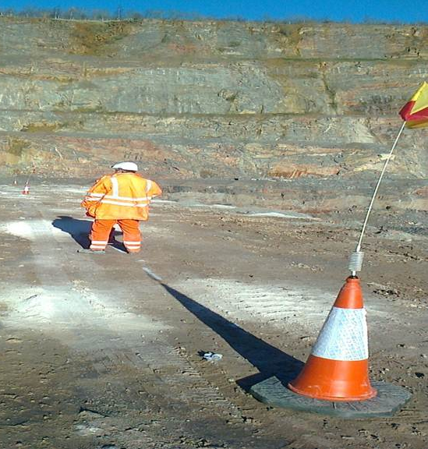
Marking The Standoff
The standoff is marked by a trained competent person to a minimum of epic level 3, using weighted traffic cones that have been adapted to take a flag. The Flag is set at eye level of the FEL driver.
A painted hatched line may be used as a back up if the cones cannot hold position during particularly inclement weather or as additional marking if required

Slide 5
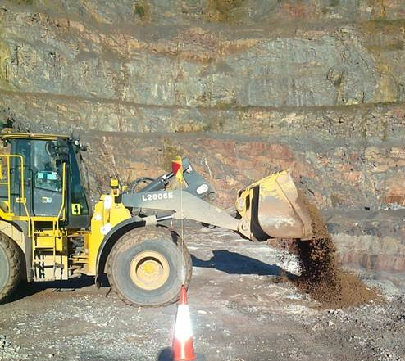
FEL approaching the Crest
On approach to the determined standoff line the FEL bucket is kept low to the ground. Following Geotechnical Specialist advice the material is bucket tipped into its final position rather than placed on the ground and pushed forwards . Pushing the bund forward could cause additional shear pressure on the crest and dislodge some ground. This also ensures that the bucket does not obscure the line of sight to either the face crest or the “line”.

Slide 6
Placing edge protection
Note the position of the front wheels behind the line marked with flags

Slide 7
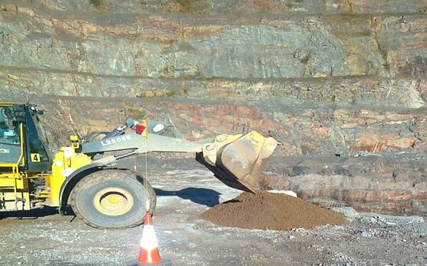
Edge protection in place
Scalpings are used as it “stands up” better and provides higher edge protection. More could be added if the required height was not met by using the same process.

Slide 8
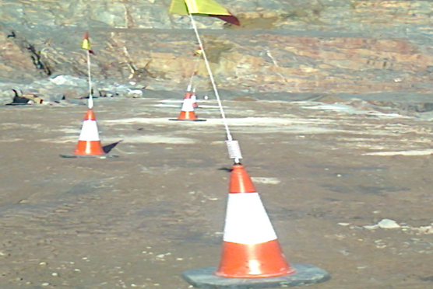
Marking out break back of the crest
When there is evidence of break back or any other fault at the crest, the area can be further demarked to preserve the 5m rule to the unprotected face

