Slide 1
Quarry Operator and Contractor
Code of Conduct
Incident Investigations

Slide 2
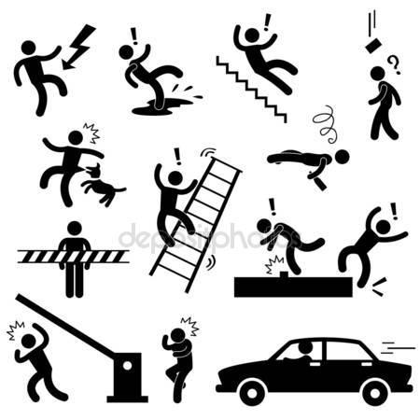
Incident Investigation
All investigations should be a partnership embodying the principles laid out in the Quarries Regulations 1999 as well as in employment law, with cooperative working to ensure immediate, underlying and root causes are established, and learning outcomes are circulated and implemented accordingly.

Slide 3

What is an Investigation?
An investigation is a fact finding exercise to collect all the relevant information on a matter.
A properly conducted investigation can enable a Quarry Operator to fully consider the matter and then make an informed decision on it.
Making the decision without an investigation can lead to unfair biased decisions which fail to identify causes and could leave the Quarry Operator vulnerable to legal action.
Notes:
Competence requirement is equally applicable to all contractors in all environments although not explicit in law

Slide 4

What should be investigated?
All incidents should be considered for investigation, Near Misses, Incidents and Accidents.
Definitions:
Near Miss – has the potential to escalate into injury or ill health to people or, damage / loss to property, plant, materials or the environment.
Incident – An unplanned event that has created damage or loss to property, plant, materials or the environment.
Accident – An unplanned event that has resulted in injury, ill health of people

Slide 5

Who should complete the investigation?
Only trained and authorised personnel should undertake an investigation, where necessary be in contact with subject matter experts. Good Practice would be to establish an investigation team.
Members of the team should come from:
  Supervisory Management
  Employees involved in the incident
  Employees in similar role but not involved in the incident
  Senior Management
  Any relevant specialists

Slide 6

Notification Process:
A notification process needs to be developed, who reports a near miss/incident/accident and who to?
The Quarry Operator has a responsibility to report RIDDOR applicable incidents to the HSE.
The Quarry Operator should initiate the incident investigation within a reasonable timeframe, dependant on severity, either immediately or within 24hrs of the incident occurring.

Slide 7

Actions
Immediate Action
  Plan the investigation
    Data collection
      Data analysis
        Corrective actions
          Reporting

Slide 8

Immediate Action:
The immediate action may include making the area safe, dealing with casualties and preserving any perishable evidence, e.g. CCTV footage

Slide 9

Plan the investigation:
What level of investigation is required, informed by severity or potential severity (will also influence the other key points below)
  Detailed
  Simple
Who should lead the investigation
  Quarry Operator
Who should be part of the investigation team.
  Site safety rep/ workforce representative
  Contractors involved (Including Hauliers)
  Site Operators representative
Are any specialists/competencies required to support the team
Who will need to be spoken to
How long will the investigation take
  Set some expectations for timescale and key milestones for the investigation
  in significant cases may need to back fill for those on the team.
Consider the process for review of the investigation

Slide 10

Data collection:
Data should come from all available sources, witness statements, photographs, procedures, risk assessments and relevant equipment print outs.

Slide 11

Data analysis:
Generate an accurate chain of events from the data collected. The investigation will need to ascertain the root cause as well as the direct cause. Asking yourself WHY? Is one way to find the root cause.
Failures and mistakes don’t just happen by themselves. Human behaviour, Organisation and Management systems all play a part in the root cause.

Slide 12

Corrective actions:
Ensure the corrective actions don’t just deal with the direct cause but also the root cause. Dealing with the root cause will reduce the risk of recurrence. Failure to look at the root cause is a missed opportunity, and leaves open the possibility of other incidents occurring from similar root cause activities.

Slide 13

Reporting:
Reports need to be written up, and will only be closed when all actions have been completed. The report needs to be used to generate further communications to identify learning points.

Slide 14
Implement improvements through:-
  Safety Alerts
    Safety Presentations
      Meeting topics
      Then, Check for effectiveness

Slide 15


