Slide 1
QNJAC Contractors Sub-Committee
Risk Management
Notes:
The purpose of this toolbox talk is to highlight sound practices to be adopted to ensure that high standards of safety and health are implemented and maintained throughout the quarrying industry.

Slide 2
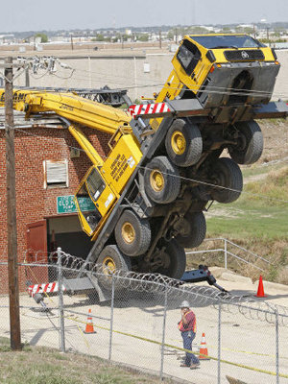
Why do we complete a risk assessment
To avoid this......

Slide 3
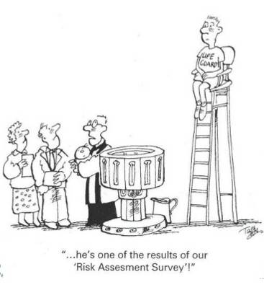
Why do we complete a risk assessment
And also to avoid this.....

Slide 4
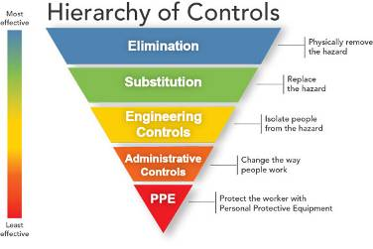
The Risk Assessment Process
The Task
Notes:
THE TASK - Be clear about the task to be undertaken and consider the impact on or from any third party working within the same area.
INVOLVEMENT - Ensure that all those in the team to do the task are actively involved in the preparation of the risk assessment
HAZARDS - Ensure to be focused on the significant hazards - those that could result in serious injury or long term health effects.
LEVEL OF CONTROL - Ensure that the hierarchy of controls is considered, do not rely solely on PPE as the primary control of the hazard
SPECIFIC CONTROLS - Ensure that the controls are specific and clear
HAS ANYTHING CHANGED - Remind all those involved to “STOP” work if anything changes and consult their supervisor/line manager before proceeding with any changes to the controls or method of work.

Slide 5
The Task
Be clear about the task to be undertaken
Consider your impact on anyone else working in the same area
Consider the impact other people working within the same area might have on you

Slide 6
Involvement
It is very important to ensure that all those in the team doing the task are actively involved in the preparation of the risk assessment
Also ensure that you include other parties that will be working in, or near, the area in which you are working.
Shift change over, ensure the RA & SSW* is discussed with those taking over and that the are happy with what is required.
* RA = Risk Assessment SSW = Safe System of Work

Slide 7
The Hazards
Ensure to be focused on the significant hazards
Those that could result in serious injury or long term health effects.

Slide 8
Level of control
Ensure that the hierarchy of controls is considered
Do not rely solely on PPE as the primary control of the hazard

Slide 10
Specific Controls
Ensure that the controls in place are specific, clear and understood by all.

Slide 11
Has anything changed
Remind all those involved to STOP WORK if anything changes.
Should anything change consult your supervisor or line manager before proceeding with any changes to the controls or method of work.

Slide 12
Increased Risk
The following situations can potentially increase the level of risk
Emergency work / breakdown
Work required outside of normal hours
Remember the same level of competencies and appropriate time spent preparing the RA and SSW is still required.

Slide 13
“No job is so important that it cannot be done safely !!!”

