Slide 1




Notes:
This presentation is designed to provide an overview of the key elements of Vision Zero and help ensure that we all have a common understanding of what it is. Hopefully, you will be able to use some slides as basis for a discussion or to ask questions. It would be ideal to have the printed leaflet and Vision Zero card available to hand out at the end of the session. You will need an WIFI link to view the videos. If this is not available I would recommend that you delete this slide but mention to the audience that the videos can be viewed on Safequarry. If you want to re-brand the slides you can delete the MPA logo and add your own. This slide can be used to remind everyone why this is important – we all want to go home safe and well everyday. You could ask the audience what they understand by the word ‘vision’.

Slide 2
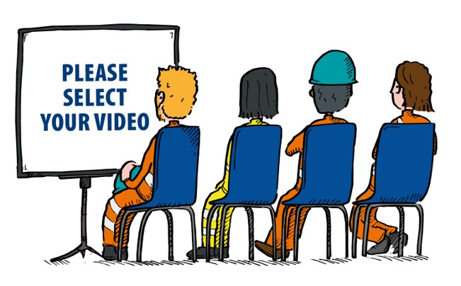
View the video for a quick overview
Click here
Notes:
This short video provides a graphic visual summary of Vision Zero. If you do not have a WIFI link suggest that you delete this file but recommend that they look at the video on Safequarry in the section on Vision Zero or go to the Mineral Products YouTube channel and search for Vision Zero.

Slide 3


Vision Zero explained
What is the main objective of Vision Zero?
Everyone
Safe & Well Every Day
Who is involved?
Everyone has a part to play - managers, supervisors, operatives, contractors
We are all responsible for our own and our colleagues health and safety
Notes:
Main purpose of this slide is to highlight what the ultimate goal of Vision Zero is and to emphasise to the audience that everyone has a key role to play in achieving Vision Zero

Slide 4
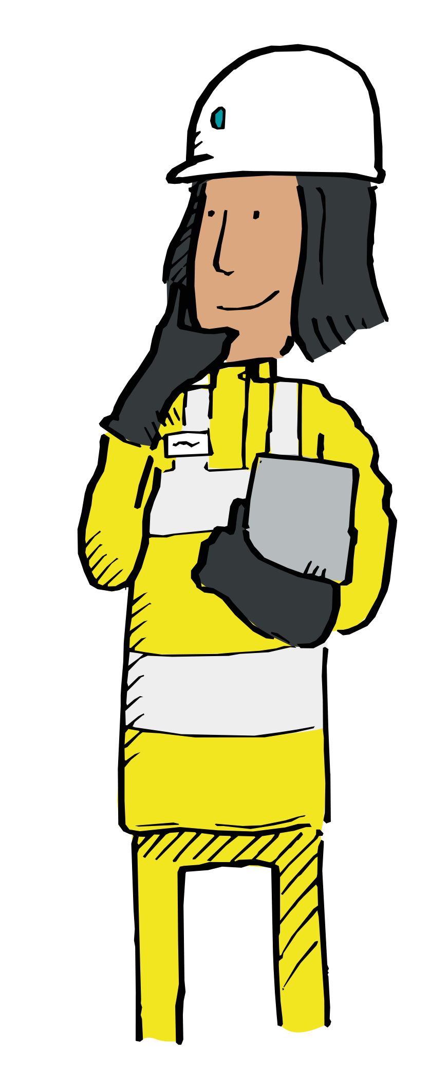
How will Vision Zero be realised?
Embracing 6 Core H&S Values
Focusing on the ‘The Fatal 6’
Following 6 complimentary MPA Strategies
Monitoring Leading and Lagging indicators and Hard Targets to track our progress
Notes:
This slide provides an overview of what is to come and effectively lists the key sections seen in the video. At the end of the Toolbox talk the hope is that everyone will know what the 6 core values are, what constitutes ‘The Fatal 6’ and why it is important to eliminate them from the workforce, and how MPA is supporting members with resources and measuring industry performance against Vision Zero

Slide 5
CORE VALUES
Notes:
You might consider discussing with the audience what is a shared value? Answers might be along the lines of:
Shared values can help to create trust, shared understanding and help link employees and organisations together.
“This is the way we work together”.
“These are the work attitudes and principles that we all agree upon and which we value”.
Employees share a common work attitudes and principles with their colleagues. This can help to build a feeling of camaraderie and a shared interest in success”

Slide 6
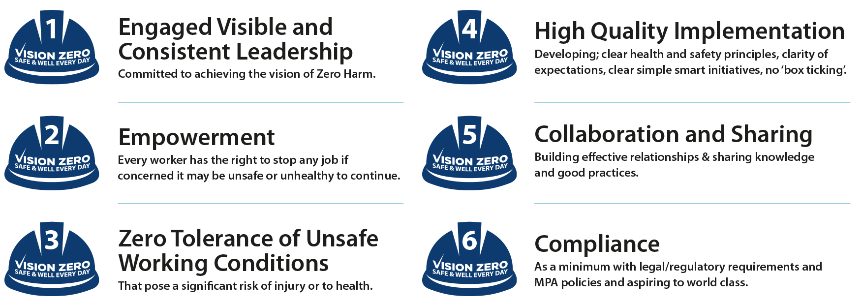
What are the 6 core MPA Health and Safety values?
Notes:
This is a summary slide. You could ask the audience for examples of these values being demonstrated in their workplace – or examples of failing to follow them. How could things be changed in their work place to help them change their behaviour or ways or working to reflect these values? You could ask them if they can think of 1 or maybe 3 things they could do that would show their commitment to these values. It is important to emphasise that Vision Zero is about everyone in the organisation from the MD downwards living and working with these values. The main point of this slide is to open a discussion about the core health and safety values – hopefully the graphics in the video will help them think about it. There is a separate PowerPoint on Safequarry that looks at the Core values in more detail.

Slide 7
At the heart of Vision Zero is the industry’s determination to eliminate the causes of fatalities, serious injuries and ill health related to ‘The Fatal 6’
What are ‘The Fatal 6’?
The 6 high consequence hazards in the Mineral Products industry responsible for 94 % of all fatalities.
Notes:
The main point of this slide is to ensure that the audience understands that the six high consequence hazards that form ‘The Fatal 6’ are responsible for the vast majority of fatalities and serious injuries within the Mineral Products industry. You could ask the audience if they can remember from the video what they are.

Slide 8
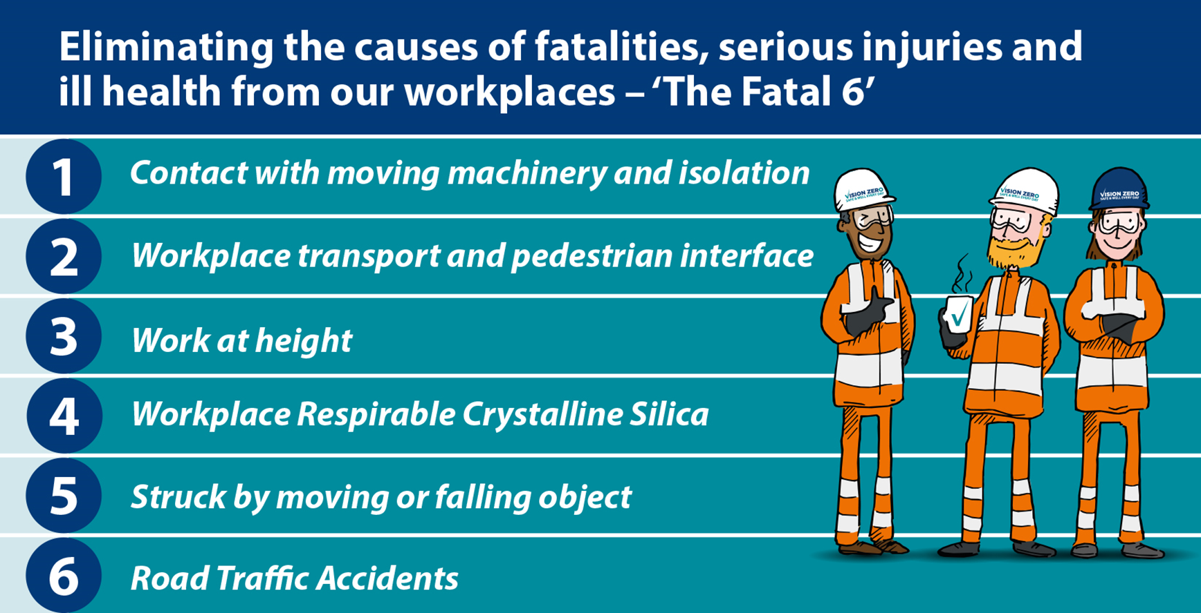
Learning to recognise and eliminate high consequence hazards associated with ‘The Fatal 6’ will make you and your colleagues safer.
Notes:
This is to ensure that everyone understands what ‘The Fatal 6’ are and why they are important. You could ask the audience can they identify any of these high consequence hazards in their work place – how could they be eliminated? Can they think of an incident or near miss that related to one of ‘The Fatal 6’? Ask how could we identify any of these high consequence hazards on our site? The main point is to use this slide to open up a discussion. Another PowerPoint is available on Safequarry that examines ‘The Fatal 6’ in more detail. Suggest they look at ‘The Fatal 6’ section of Safequarry

Slide 9
MPA’s Strategy and Performance Indicators
Notes:
The next 3 slides provide an overview of the MPA and members strategy in terms of Vision Zero and the ways in which progress will be measured. After these 3 slides the PowerPoint shows resources produced by MPA that can help to remind people about Vision Zero. You could have copies of these resources to hand out when you come to these slides.

Slide 10
6 strategies for MPA and its members to follow
An unrelenting approach to eliminating the things that can kill or seriously harm people through adoption of industry safety principles and good practices focused on ‘The Fatal 6’.
Developing competent and committed leaders at all levels.
Promoting recognition as a means to support a positive culture within the workforce.
Creating forward looking measurement systems which balance the measurement of ‘the presence of safety’ with the ‘absence of incidents’.
Helping members to create workplaces where health and well-being is protected and promoted.
Actively promoting and facilitating engagement from all member organisations
Notes:
These 6 strategies provide a general background to the key elements of the Vision Zero strategy and align with the core values. Leaders includes supervisors / foreman / individual responsible for specific task working with others. Main point of this slide is to emphasise that everyone is evolved – senior management should be facilitating their organisation delivering the strategy. You could discuss what each of these means to the audience and how they can help to bring a strategy to life. It For an audience which is mainly formed of operational or maintenance staff, drivers etc. the focus might be more on number one (although they could also discuss “Recognition” amongst their own team and how they recognise each other’s good behaviour). For managers and supervisors discussion could be extended to items 2 – 6.

Slide 11

3 Hard targets to help measure our success
Hard Target 1 - Zero Reportable Incidents (fatalities or serious injuries) relating to ‘The Fatal 6’ by 2025.
Hard Target 2 - A 50% reduction in Lost Time Injury Frequency Rate (LTIFR) to 1.5 by 2025.
Hard Target 3 - Zero incidences of uncontrolled personal exposures to RCS above the Workplace Exposure Limit (WEL) where the hierarchy of control has not been applied.
Notes:
Highlights the key targets that will be used to measure progress. Remind them of the MPA strategies.. By following these strategies we will reduce ‘The Fatal 6’ reportable incidents to zero

Slide 12
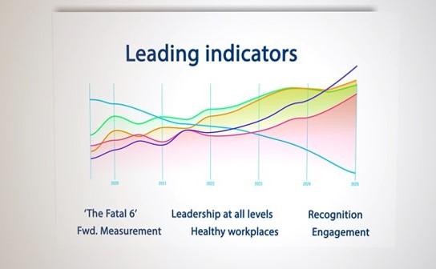
Leading Indicators – activities that help improve health and safety at work
‘The Fatal 6’ incidents will fall as we increase the activities on the left
Achieving more of the following:
Auditing of isolation
Driver and contractor competency/skills cards
Participation in H&S Leadership workshops
H&S Good Practice awards submissions
Sharing of High Potential incidents
Occupational health screening
Routine monitoring of silica exposures
Engagement in MPA H&S events
Engagement in MPA Safety Days
Engagement with MPA’s ‘Safer by Sharing’
Engagement with MPA’s ‘Exchanging Places’
Notes:
This slide shows MPA’s leading indicators that have been agreed with member companies will help the industry achieve Vision Zero. They are the type of activities we need to increase, by doing more of these activities we can assume that we will see a reduction in those items we are measuring and show actual events – the hard targets on the previous slide. As the leading indicators go up the graph shows the predicted fall in ‘The Fatal 6’ You could ask which of these or alternative leading indicators could be used them measure the presence of safety on their site/organisation

Slide 13

What resources are available on Vision Zero?
Videos and other resources on www.Safequarry.com provide an overview of key elements of Vision Zero
The Employee guide provides a quick reminder and summary of Vision Zero
Notes:
This would be a good time to hand out the resources and possibly follow the link to Safequarry to show them where they can view the on-line resources and videos about Vision Zero

Slide 14
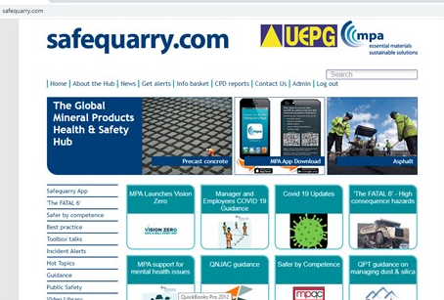
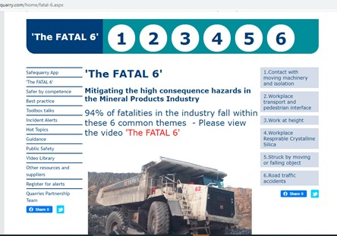
www.Safequarry.com & Safeprecast.com
Safequarry also provides lots more information on ‘The Fatal 6’ and much, much more..
Notes:
If you have time this would be a good opportunity to also show them ‘The Fatal 6’ section of Safequarry where they can see Guidance, best practice, incident alerts that relate to each of ‘The Fatal 6’. You could recommend that they register on Safequarry to receive incident alerts, toolbox etc. Or have a look at the site when they have the time. It is the central hub for health and safety information for the mineral products industry.

Slide 15


Keep the Vision Zero card on your desk, in your vehicle or in your pocket as a reminder
Notes:
Hand out the card if you have them (they can be ordered from david.yelland@mineralproducts.org) - Urge them to regularly review the items on the card. Ask them where they could put it so they see it on a regular basis. If you do not have the card this slide can be used as a useful summary and reminder for the audience.

Slide 16
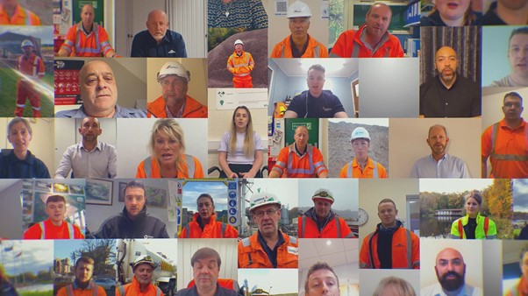
Vision Zero - views from your colleagues from across the industry about H&S
Click here
Notes:
This is a powerful short video that reflects on the importance of health and safety – this slide is a good way to close the Toolbox talk as it shows a wide variety of organisations and individuals. After viewing you could take the opportunity to ask them what they think about the video – what comments had a particular impact and why? Hopefully, this can be used to facilitate an open discussion. What did you think of the video? Now we have run through Vision Zero what comments do you have?

Slide 17
Notes:
Final slide - Remind everyone why this is important – we all want to go home safe and well everyday.

